Slide 1

AUSD Facilities
Board Study Session
March 2021
Notes:
Turn on Pointer
Open notes
Hello President Brown, Board of Trustees, and guests. I will be presenting an overview of the AUSD Facilities Department. My goal is to keep this short and simple. Feel free to speak up with any questions as they arise.

Slide 2

We provide the foundation for student success.
Notes:
The M&O staff have been working in person throughout the Pandemic to ensure our students and staff a safe learning environment. We have used every opportunity to clean, maintain and beautify our district. With that I will take you on a brief tour of our School sites and properties.

Slide 3
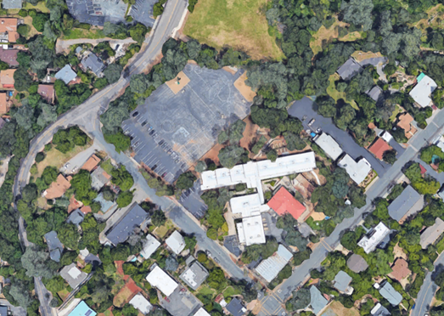

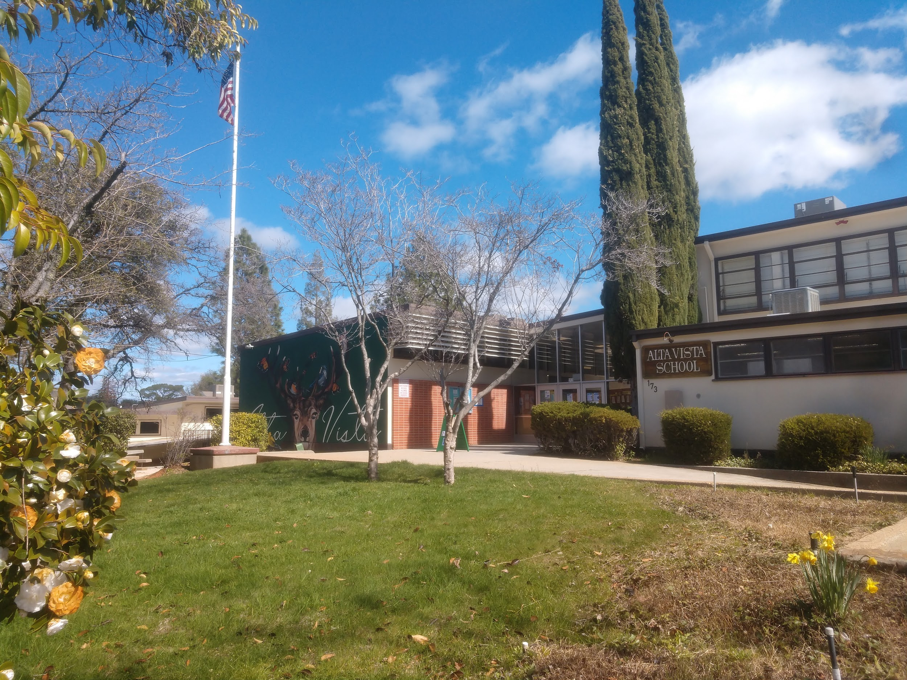
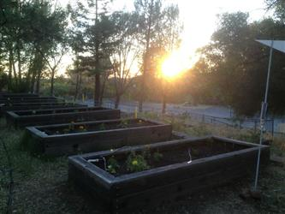
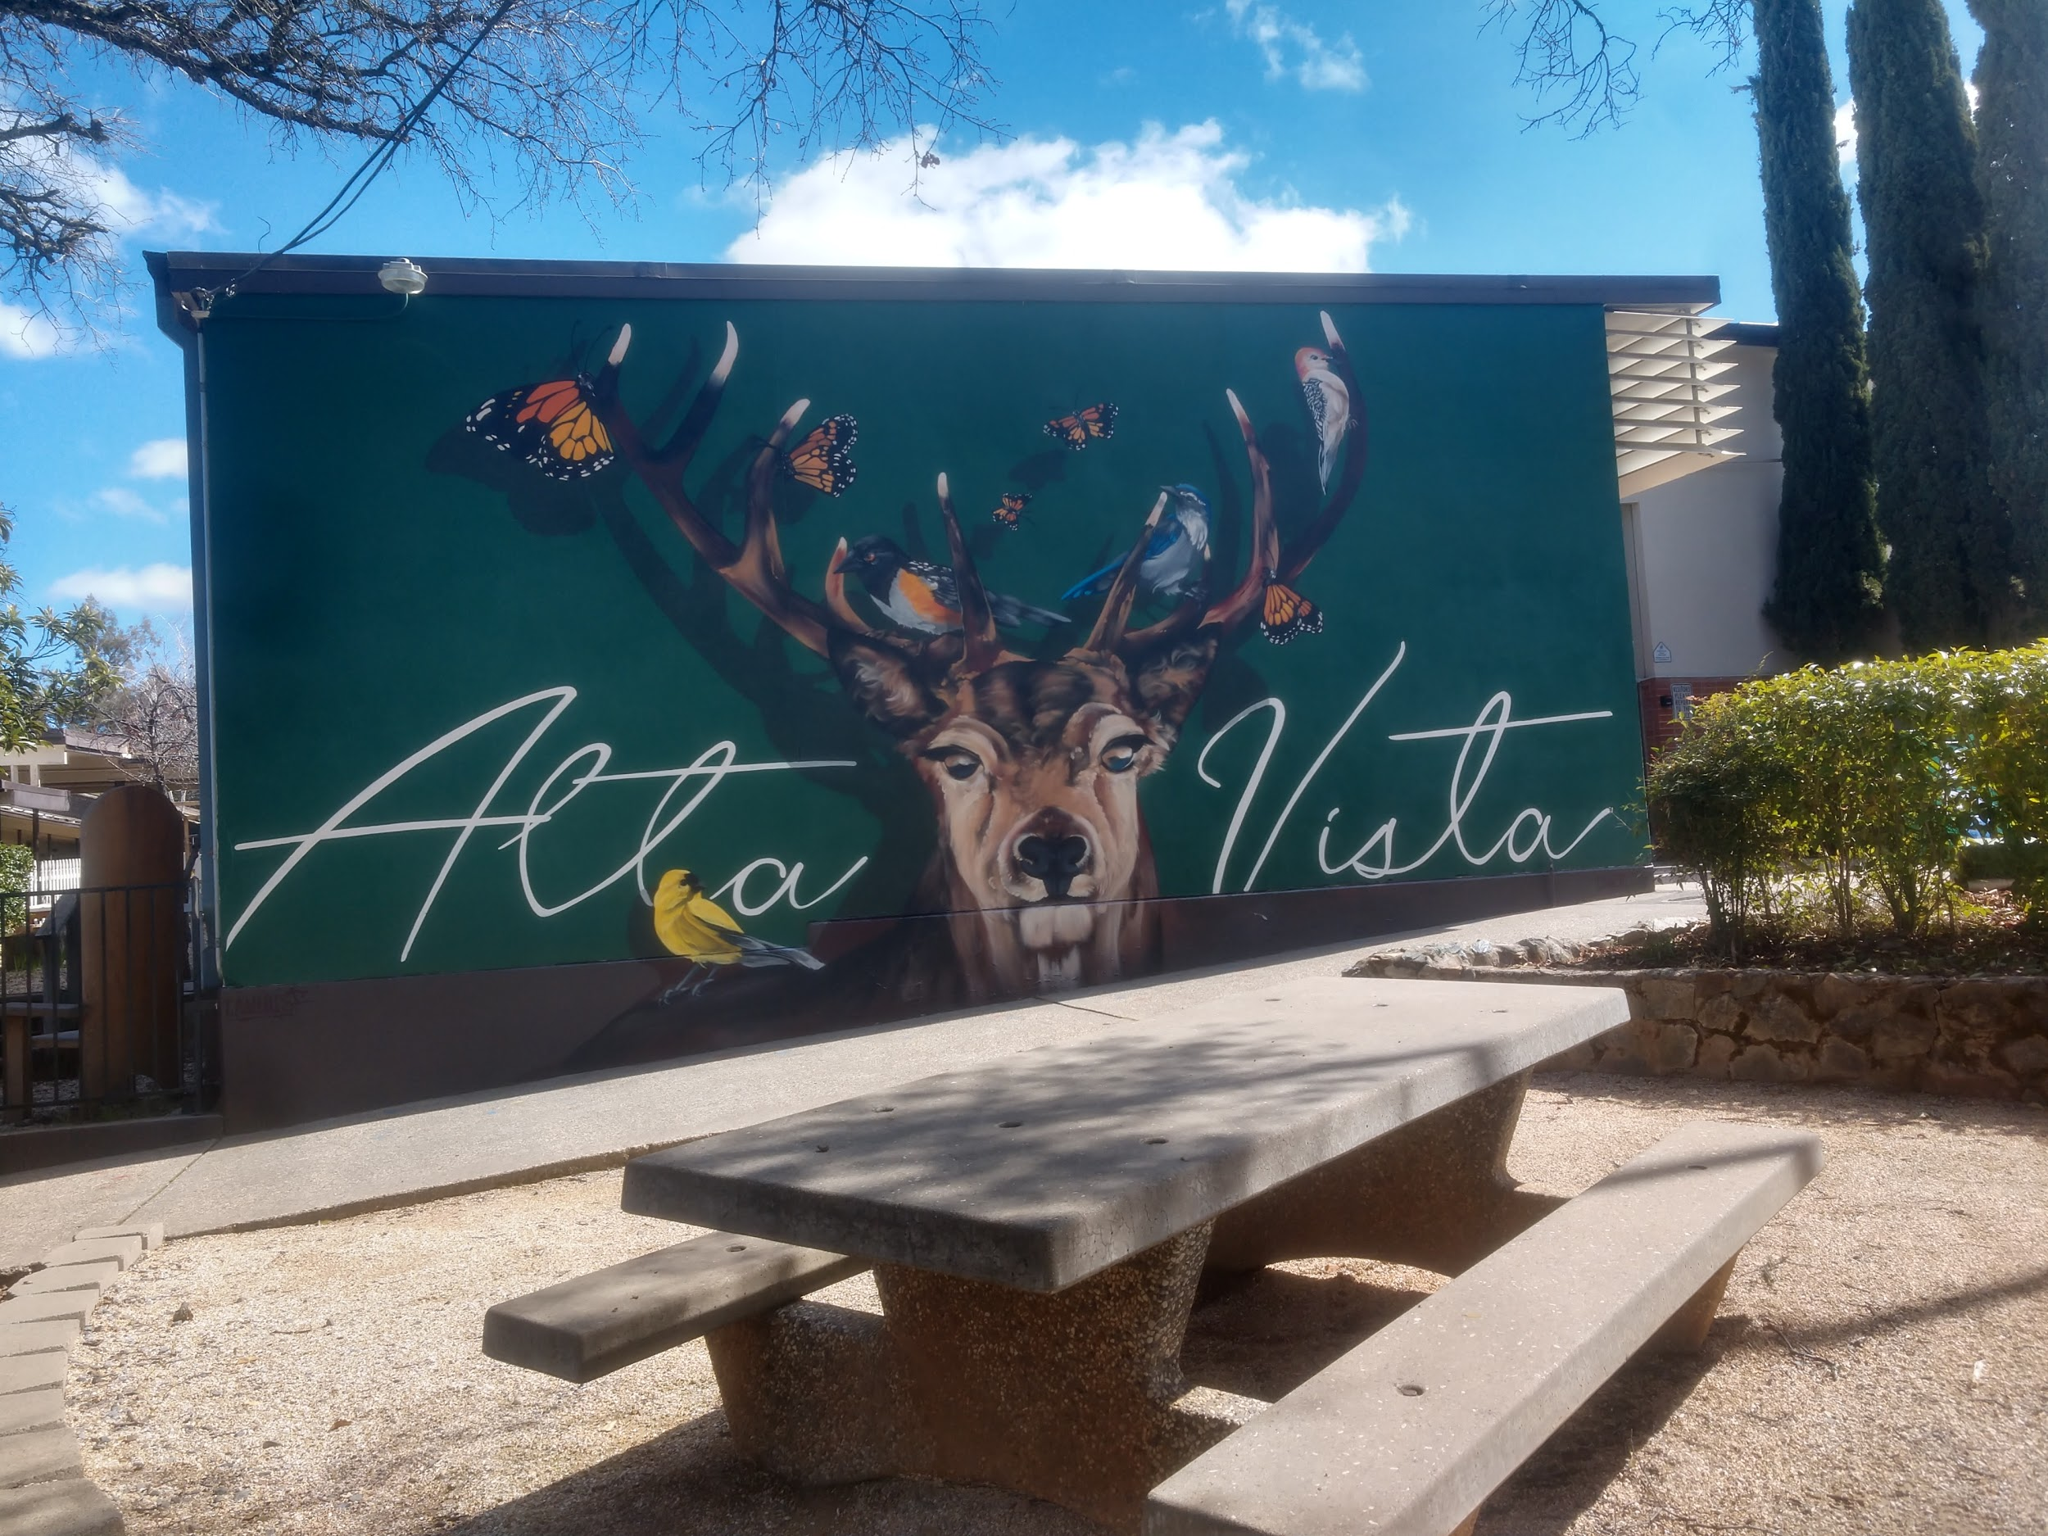
Alta Vista Charter
19/20 enrollment = 157
+ 58 preschool
Built in 1936
3.64 acres
Notes:
Alta Vista had a student population of 157 + 58 in preschool for the 19/20 school year. Originally built in 1936, with later builds every decade from the 50’s to the 80’s. At 3.64 acres this is a small but beautiful school with a lot of needs due to the age of most of the buildings. My favorite parts of the school include the nature trail, the new mural and the garden space. Volunteers are currently working on a new fence line at the sports field, adding an orchard and some resolving some erosion control areas. The roofing, flooring and painting will need modernization as soon as funding allows.

Slide 4
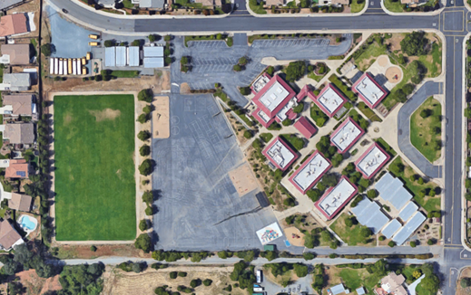

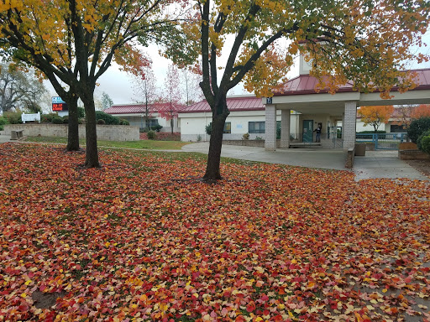
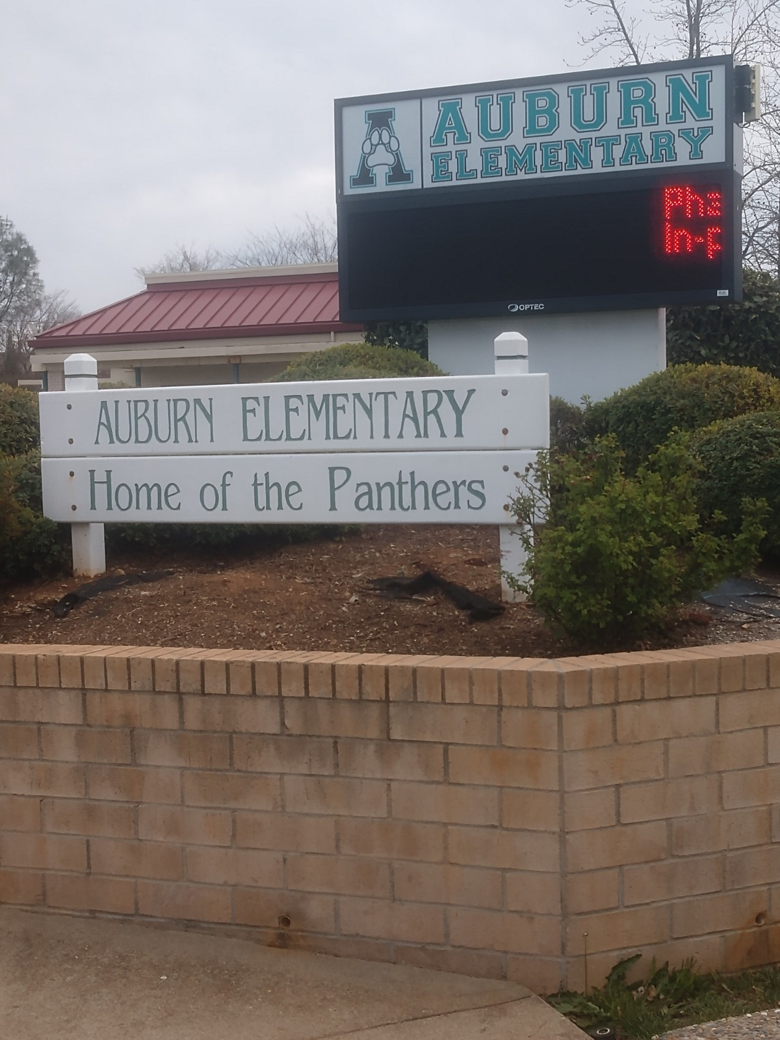
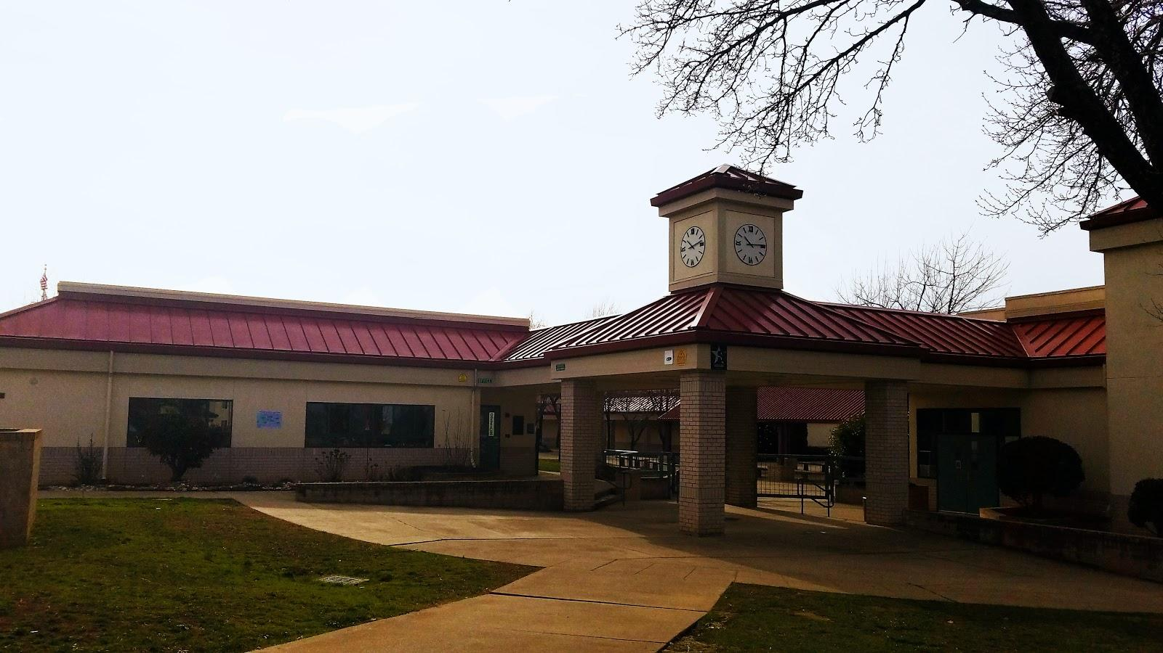
Auburn Elementary
19/20 enrollment = 390
Built in 1995
12.4 acres
Notes:
Auburn Elementary had a student population of 390 for the 19/20 school year. All buildings were built in 1995 making it our newest school. This school was well laid out with a very large playground area good student dropoff and pickup areas and a comfortable interior campus. Look forward to new playground equipment being installed over spring break. Siding, painting and flooring will need repairs as funding allows.

Slide 5

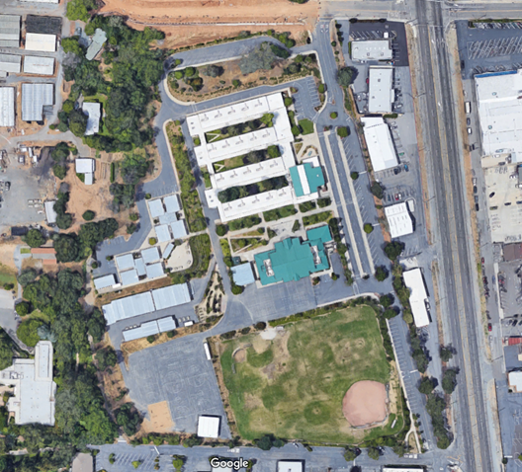
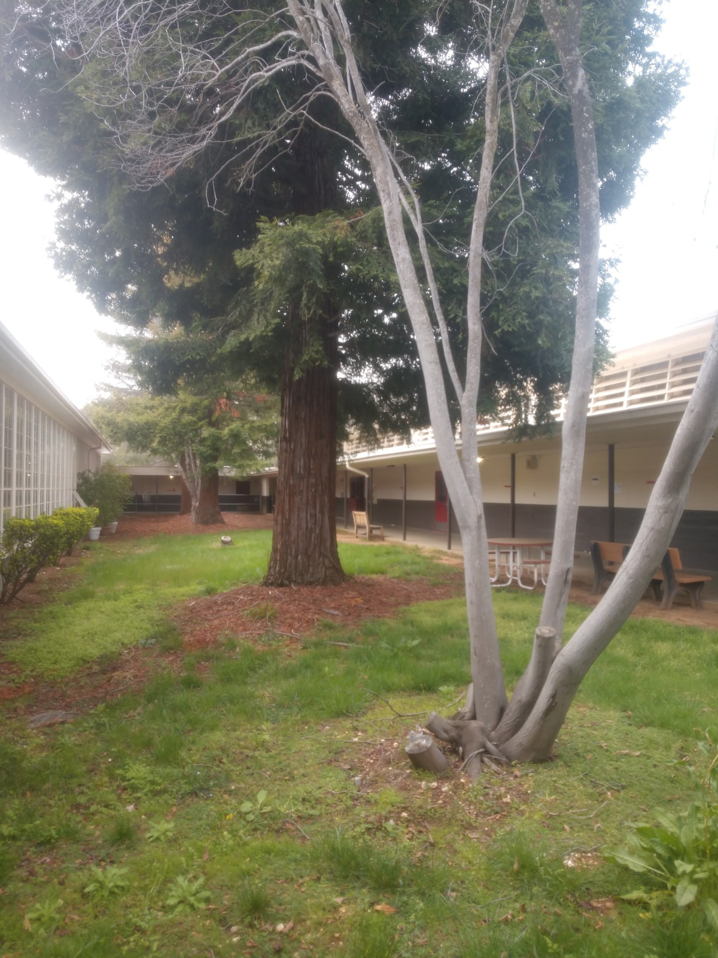
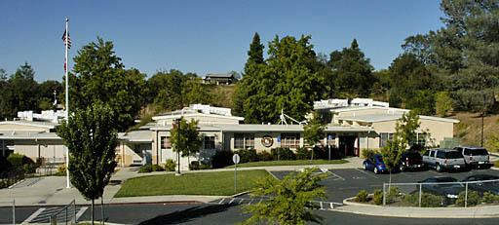
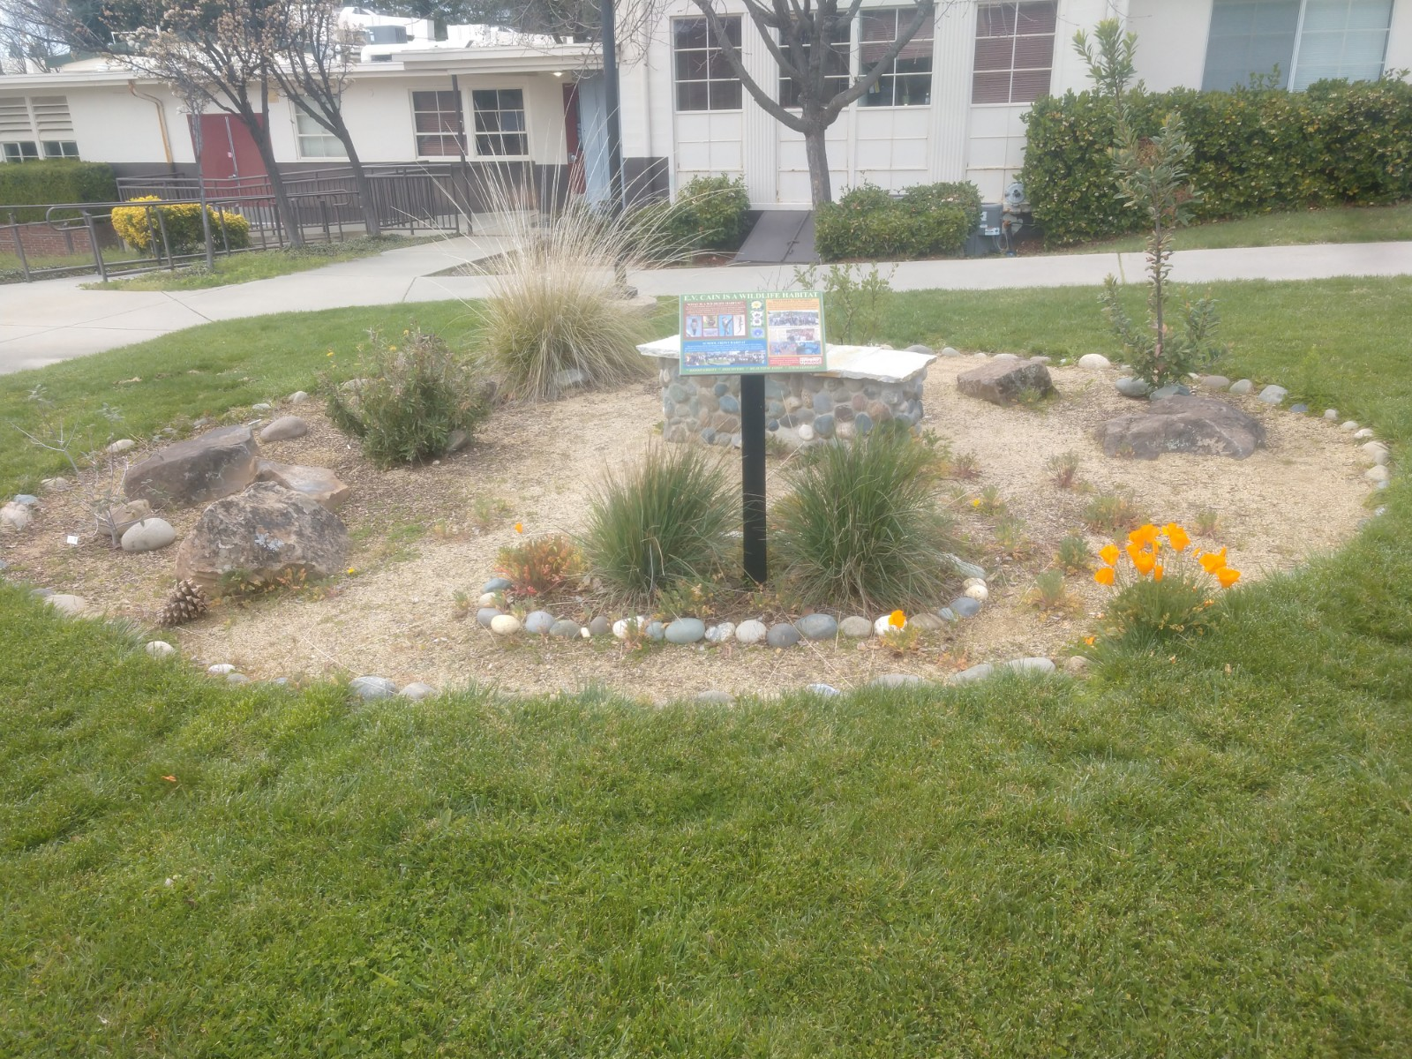
EV Cain Middle School
19/20 enrollment = 661
Built in 1949
15.1 acres
Notes:
EV Cain had a student population of 661 in the 19/20 school year. Originally built in 1949 with later builds in 1996. At 15.1 acres this is a very large campus and has by far the largest student population. For this reason we have a extra night custodian to help keep up with all the cleaning needs. The old trees in between the older wings and the nature areas of the school are my favorite parts of this school. New playground equipment was installed this past summer with seating for that area coming during spring break. Roofing, gutters, painting and flooring need repairs as soon as funding allows.

Slide 6
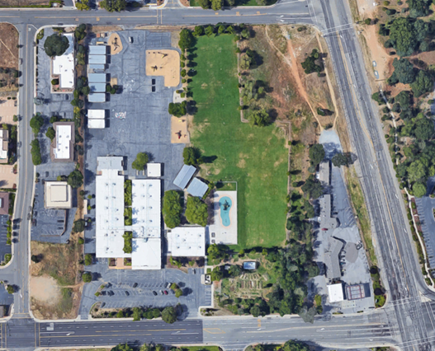

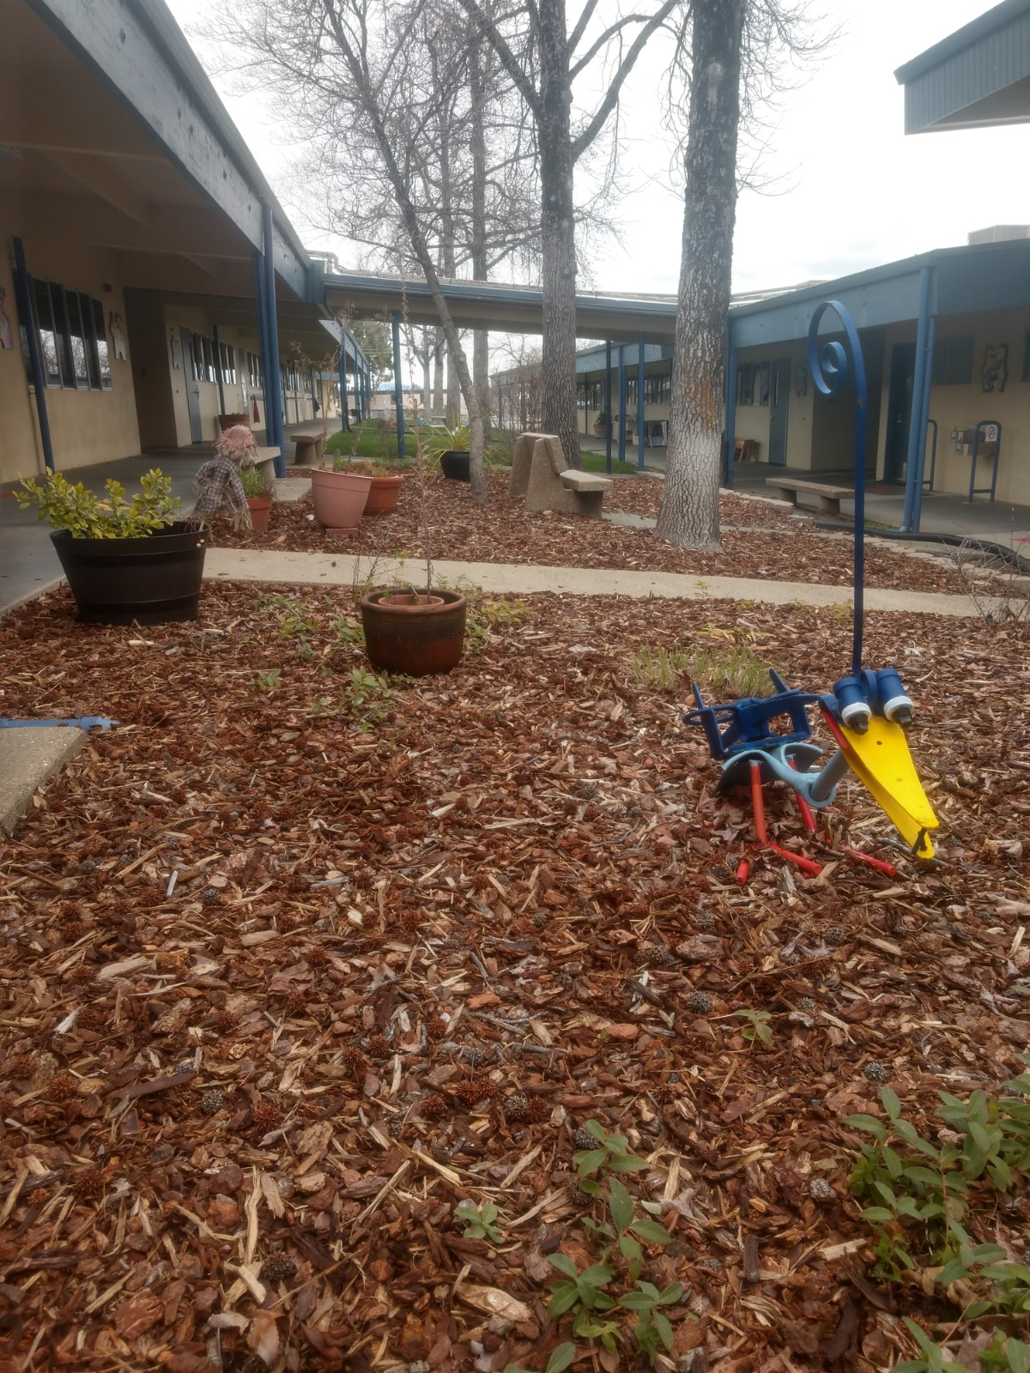
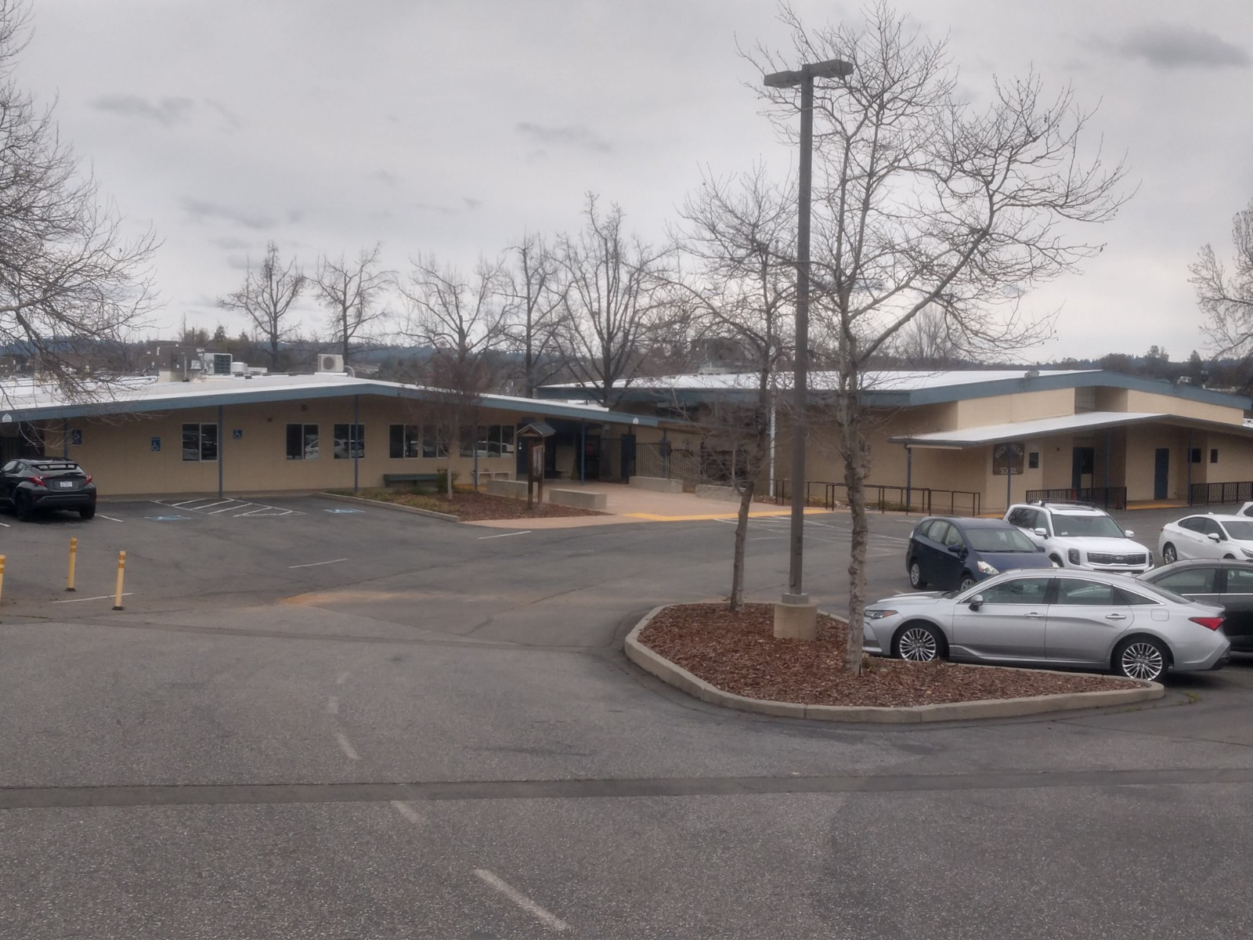
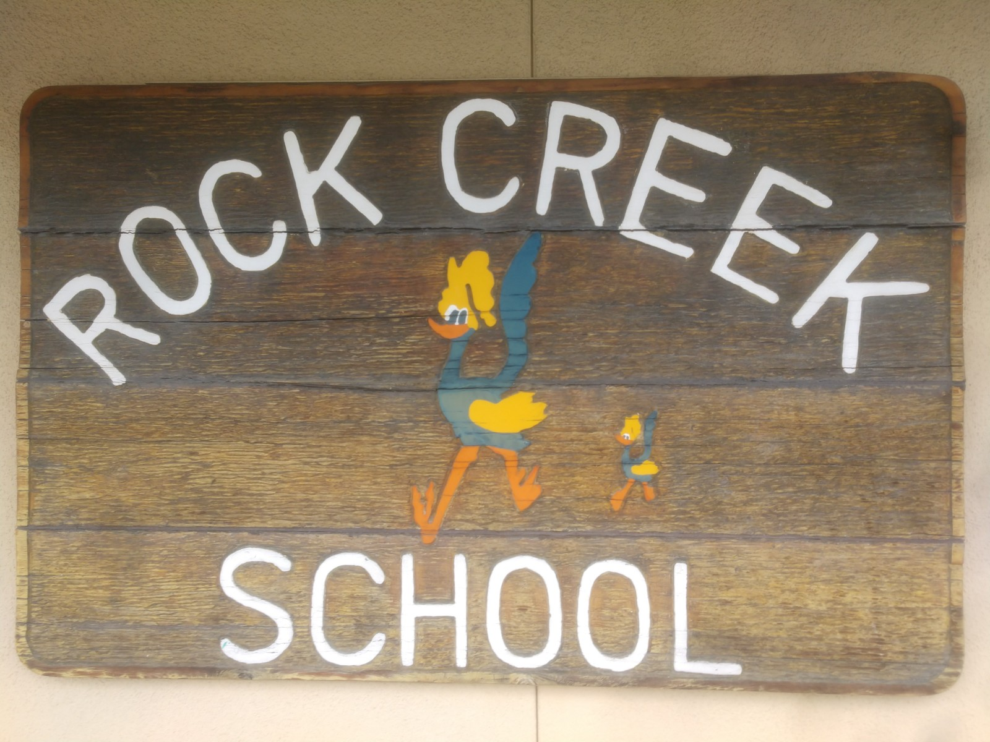
Rock Creek Elementary
19/20 enrollment = 298
Built in 1965
4.02 acres
Notes:
Rock Creek had a student population of 298 in the 19/20 school year. All permanent buildings built in 1965. This is one of our older schools and needs extra maintenance attention. Current issues of the school include leaking underground pipes and storm water drainage deficiencies. Both are being addressed. Special attention has been made to beautify the interior lawn and landscaping. My favorite aspects of this school is the artwork around the school and the 4 different playground structures. Plumbing, drainage, roofing, flooring and painting need repair as soon as funding allows.

Slide 7
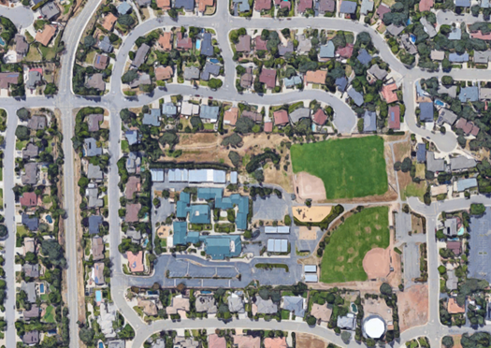

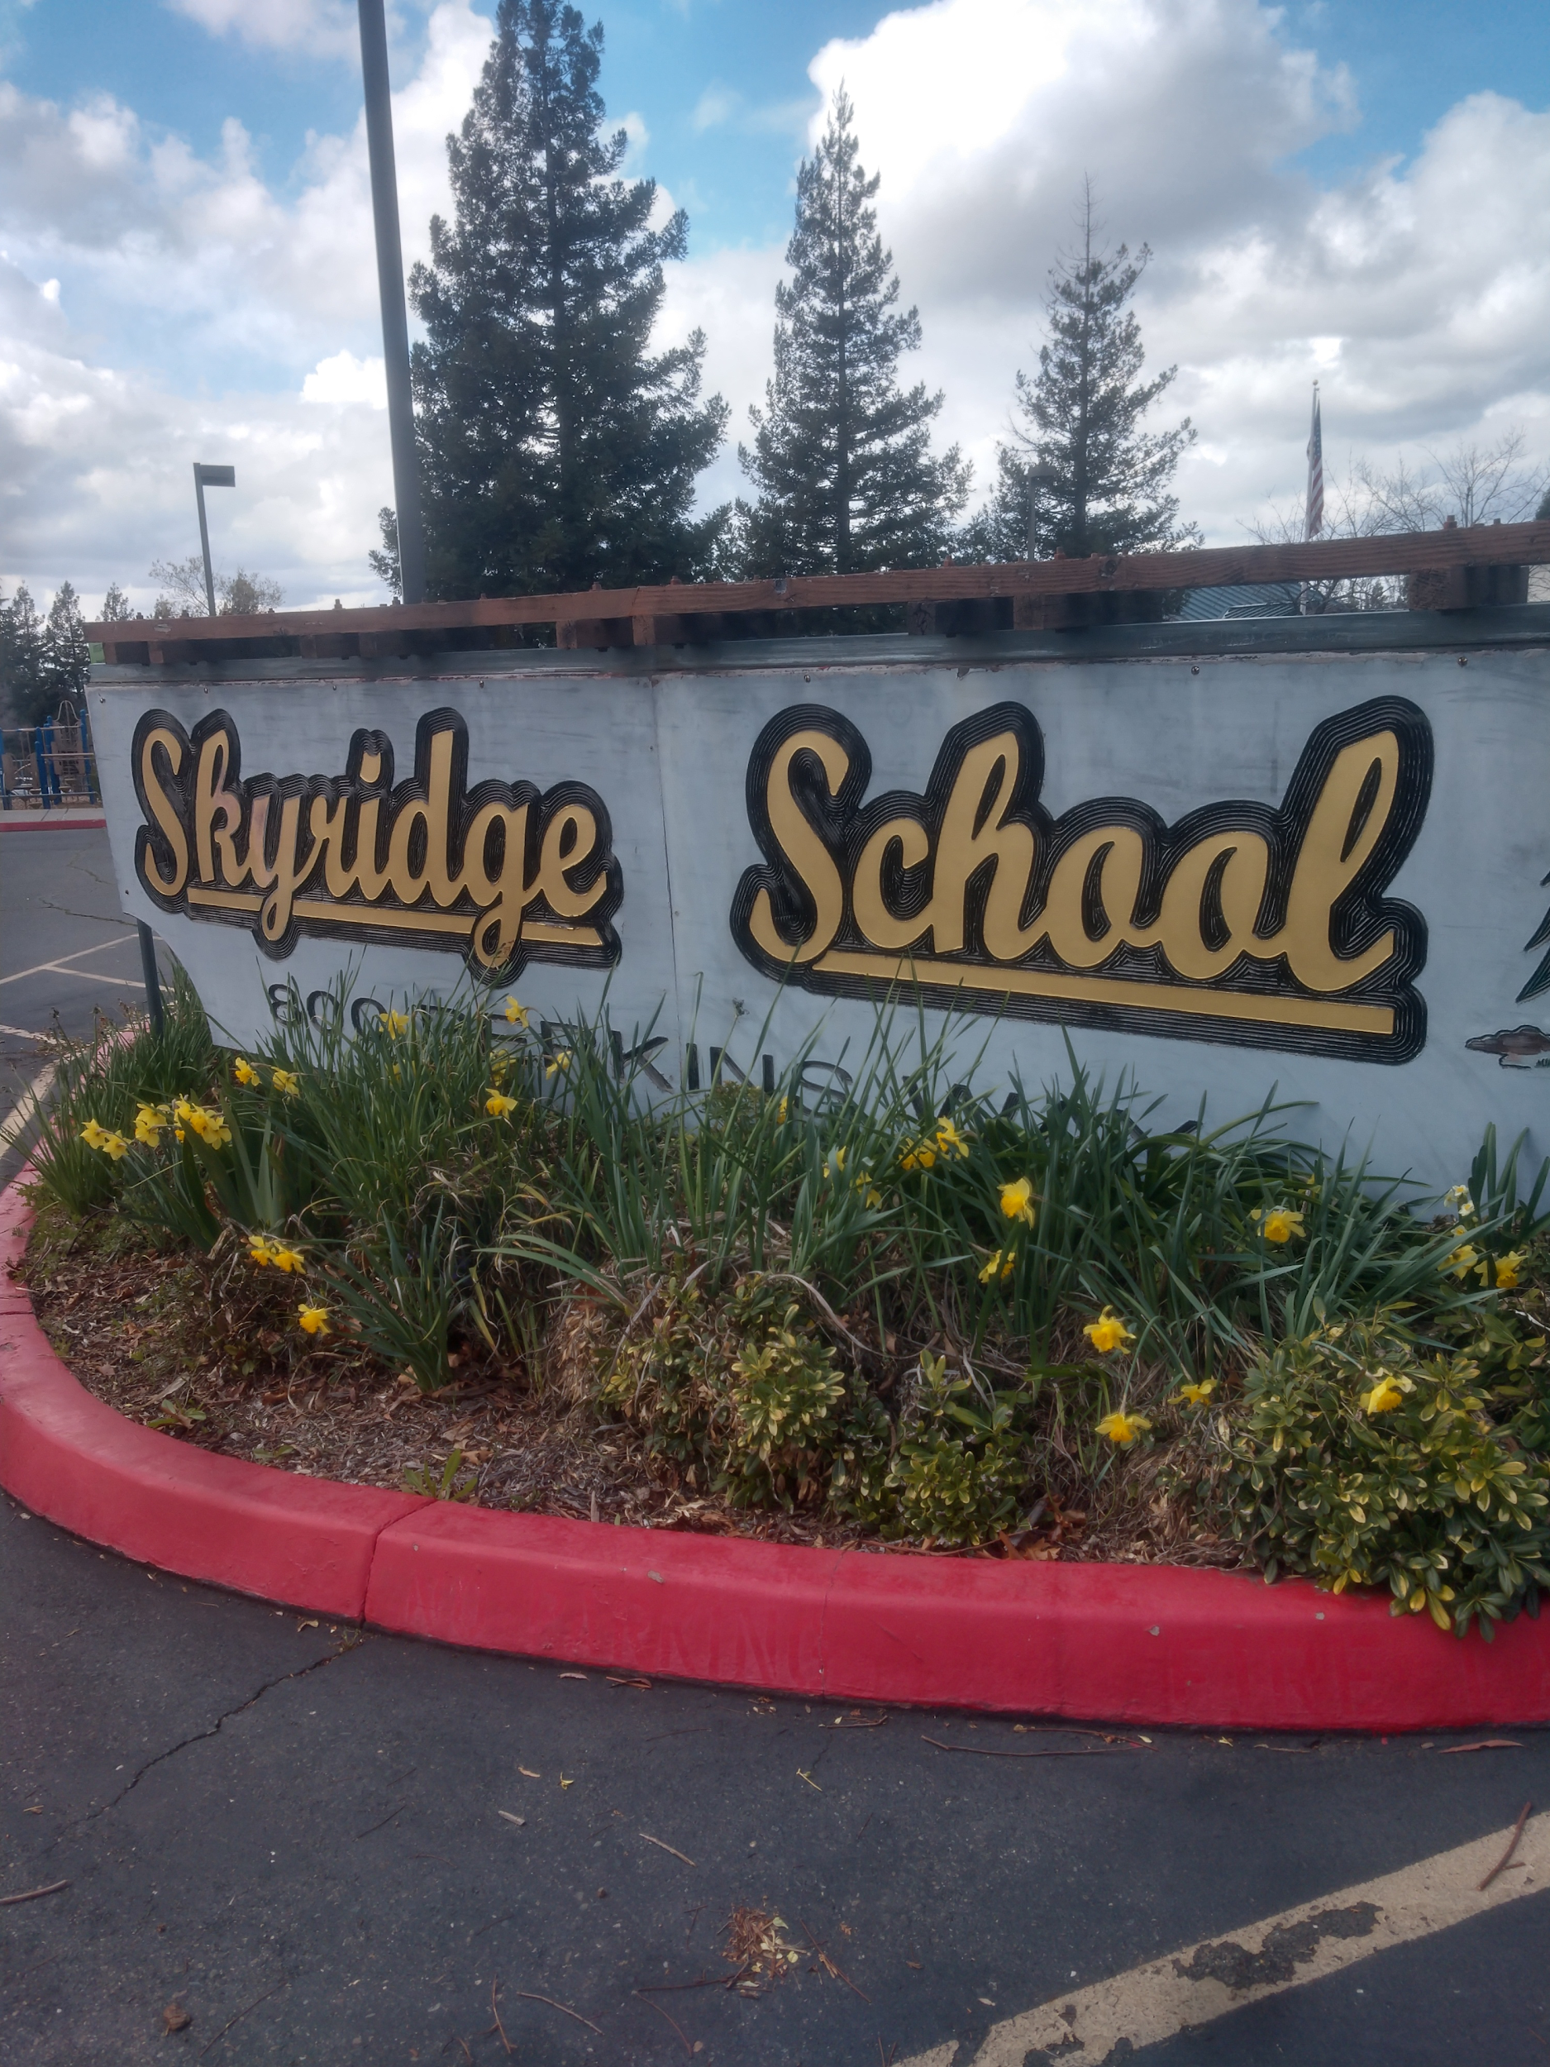
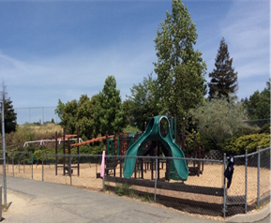
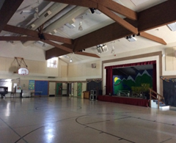
Skyridge Elementary
19/20 enrollment = 379
Built in 1994
14.2 acres
Notes:
Skyridge had a student population of 379 in the 19/20 school year. All permanent buildings were built in 1994. One of our largest schools, has 2 large sports fields, a nature trail, an outdoor amphitheatre and a comfortable courtyard setting. The exposed beam construction throughout the campus is a nice feature, but because of its exposed nature, is beginning to weather and will rot if not addressed in the coming years. Some roofing repairs as well as flooring and painting will need to be addressed as soon as funding allows.

Slide 8
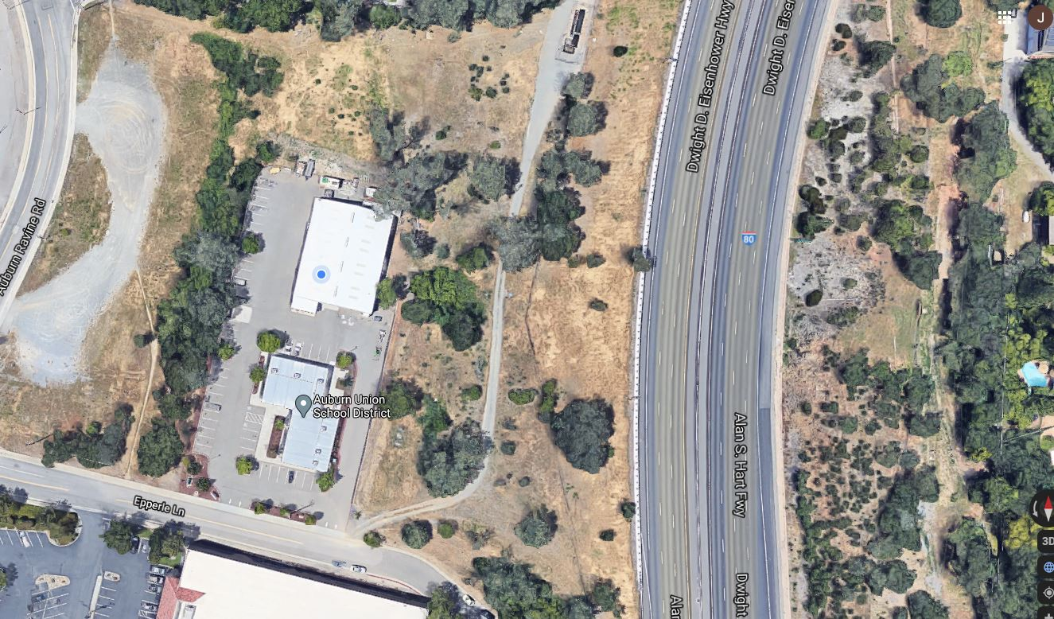
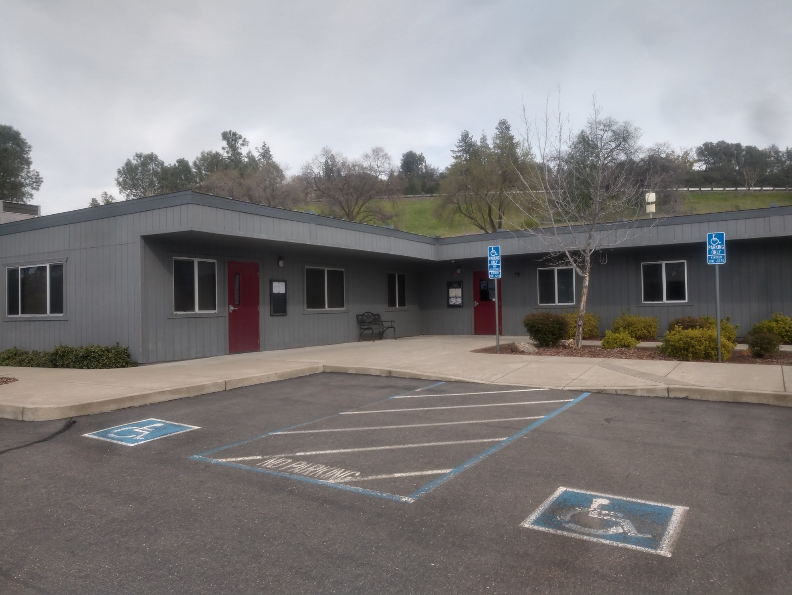
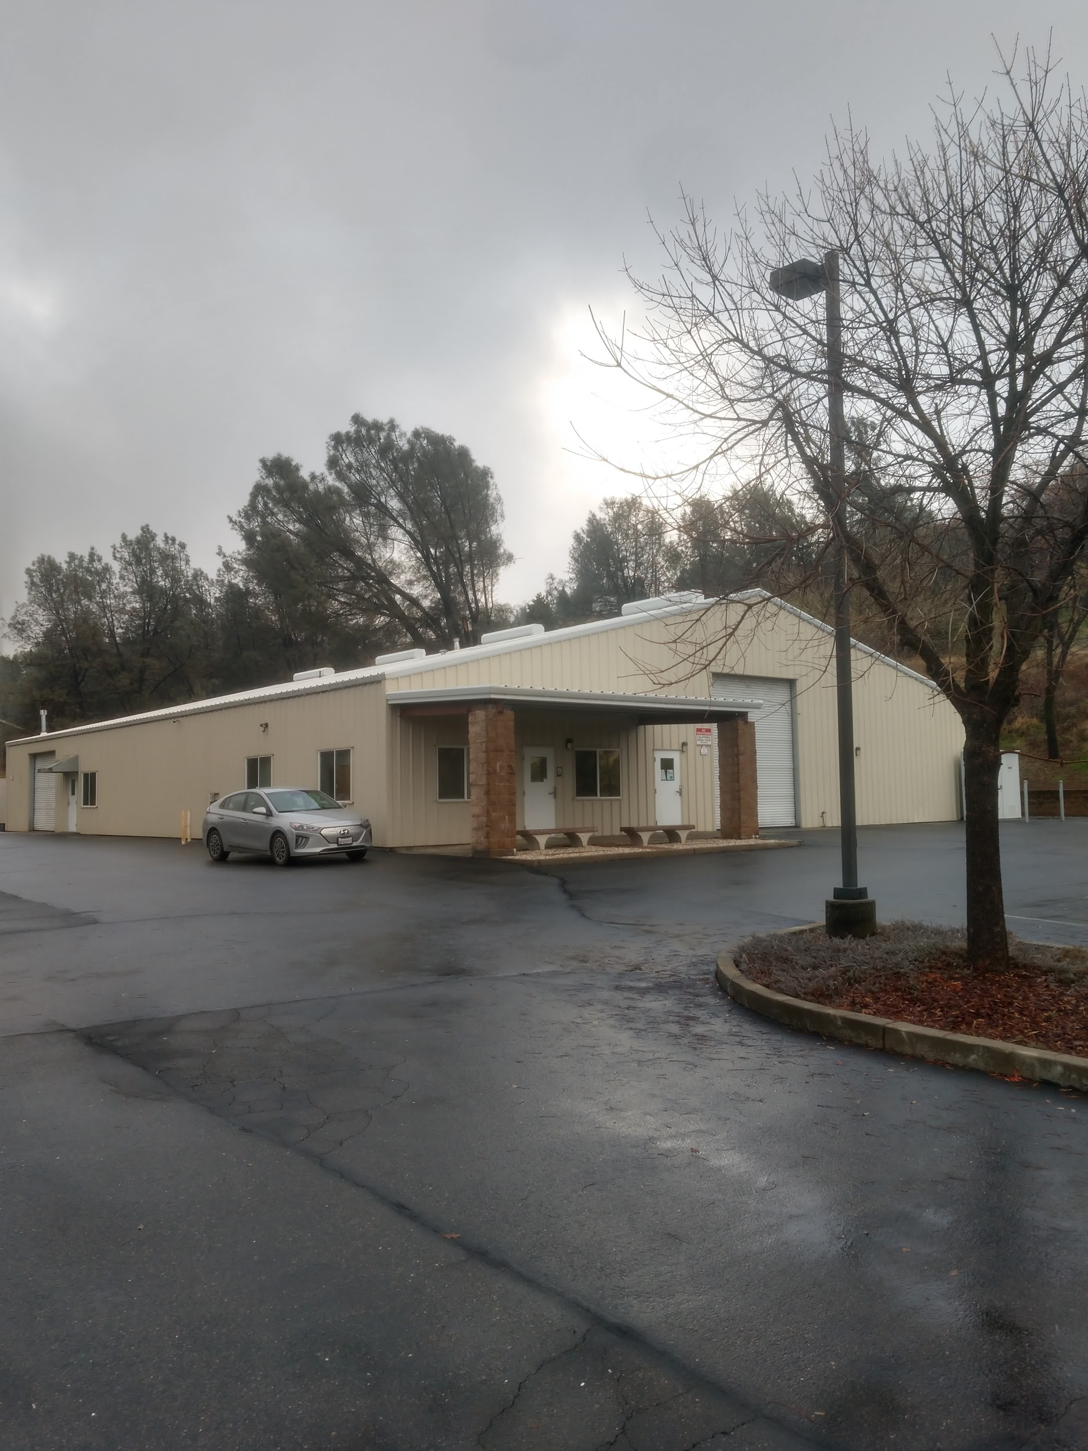
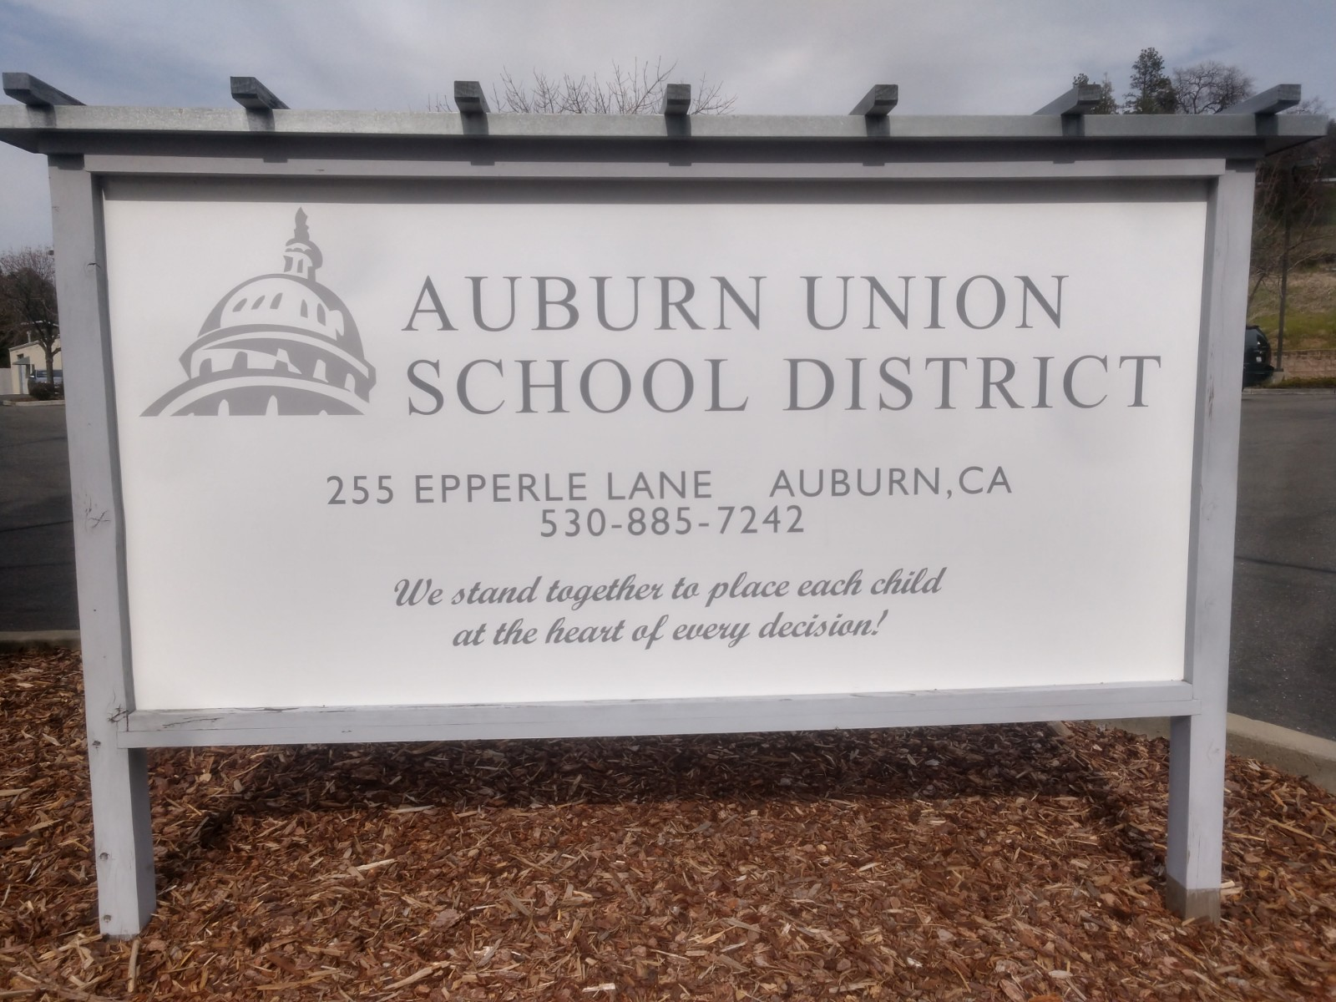
District Office and Warehouse
Purchased in 2003
1.4 acres
Notes:
Central location
Spacious warehouse : used to store food, supplies, equipment, books, saved files and custodial supplies
Room to expand
Ongoing homeless issues
Almond trees

Slide 9
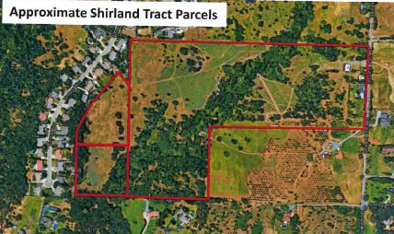
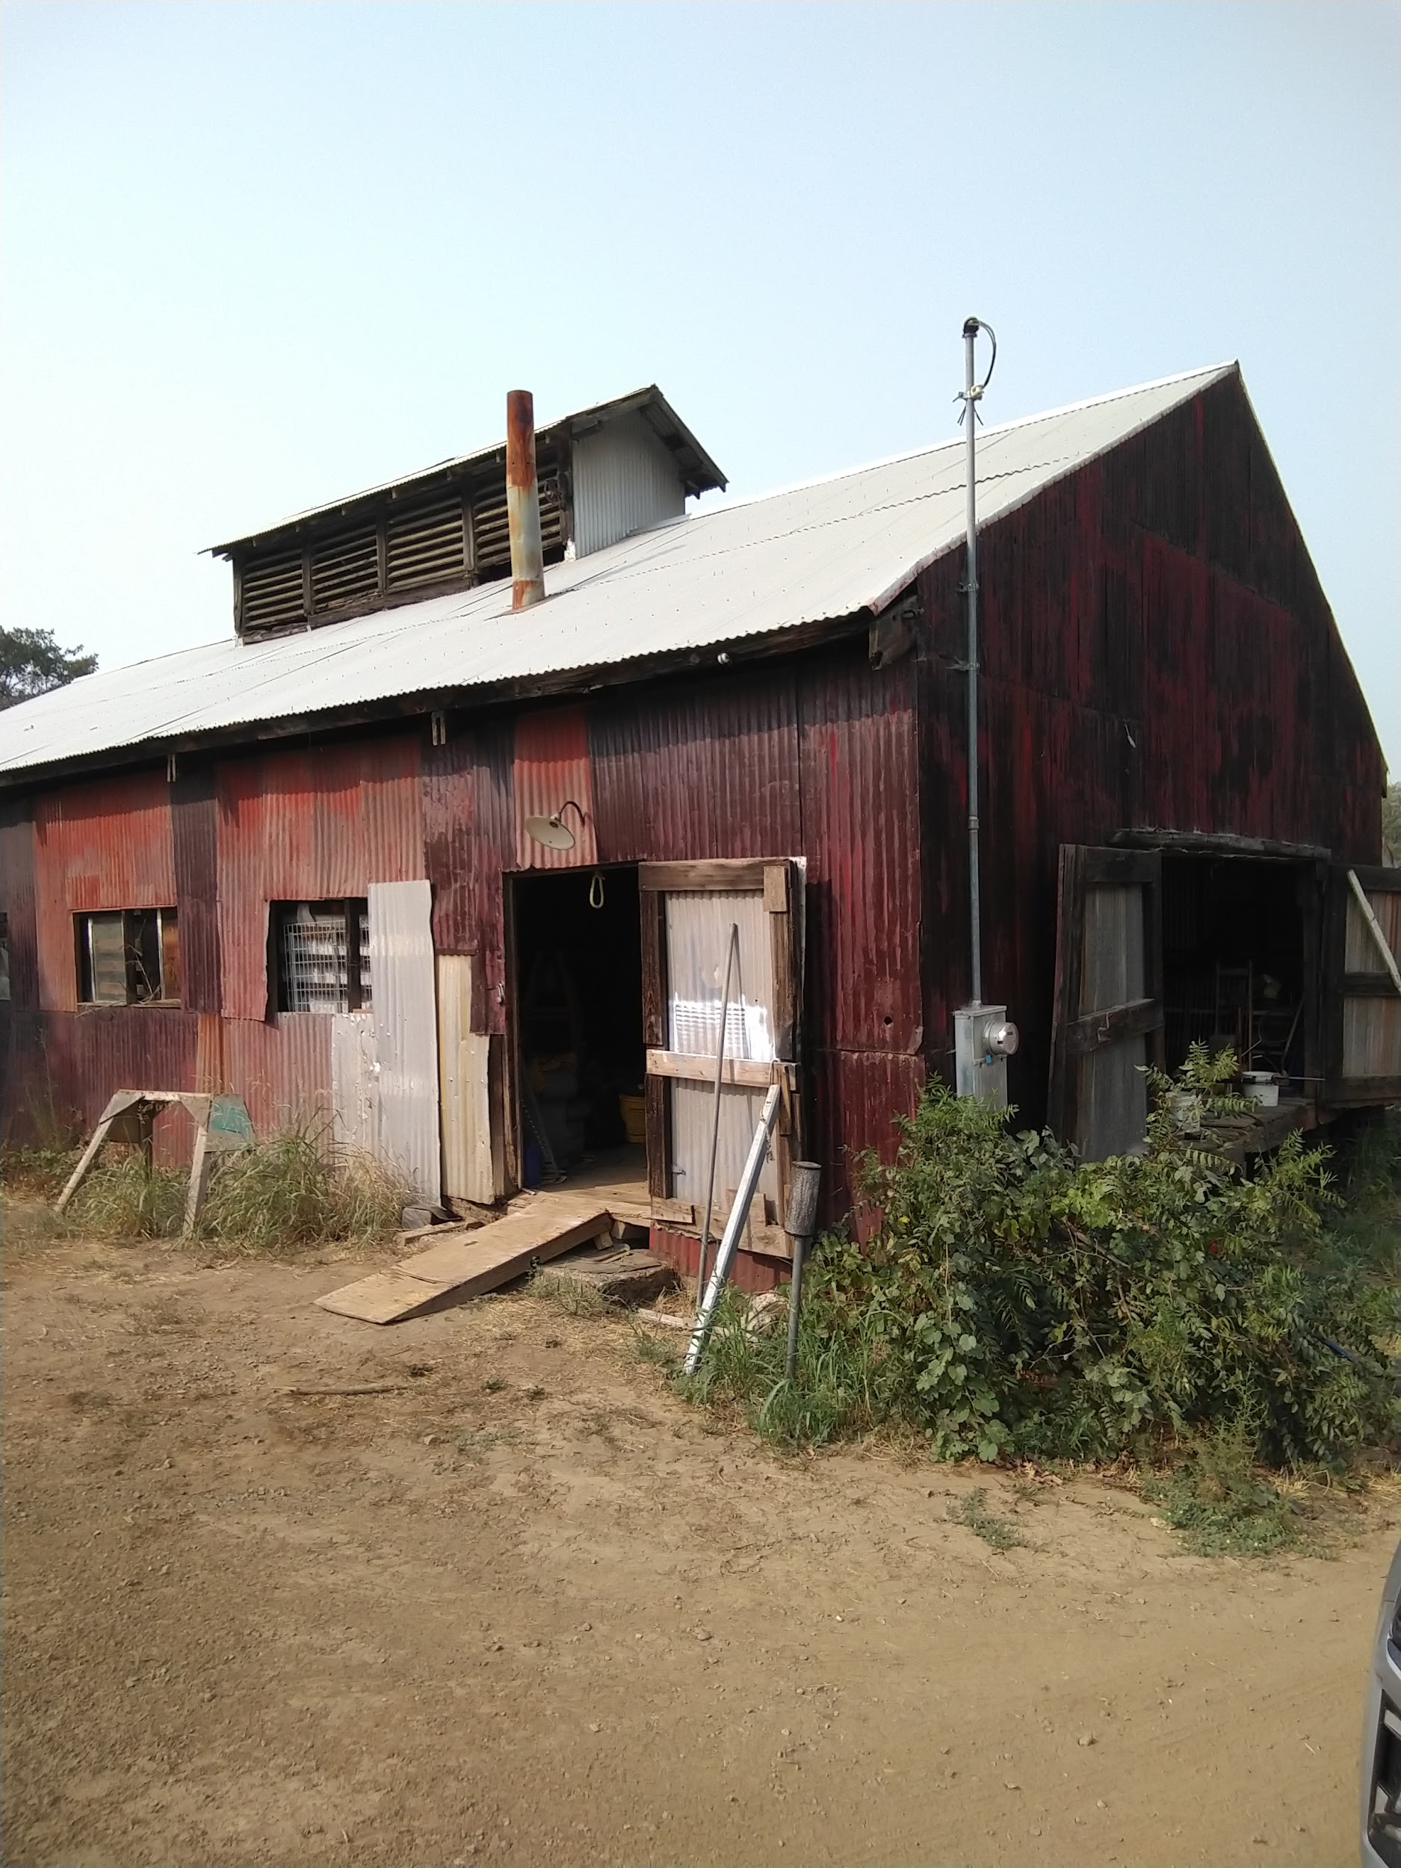
Shirland Tract Property
Undeveloped
Acquired after 1991
47.42 acres
Notes:
Largest fire break about 3-4 days to clear
Homeless issues
Unusual/uncomfortable relationship with neighbor
Pear and apples

Slide 10
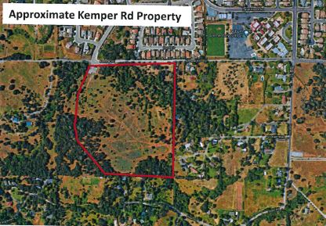
Kemper Road Property
Undeveloped
Purchased in 1994
26.2 acres
Notes:
2 day fire break
Fruit trees -plum persimmon, pear

Slide 11
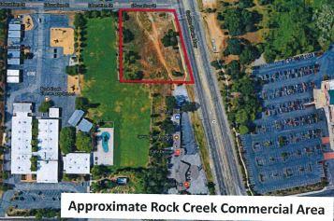
Rock Creek Commercial Property
Undeveloped
Undivided from Rock Creek School
45,000 square feet
Notes:
Smaller fire break
Homeless issues

Slide 12
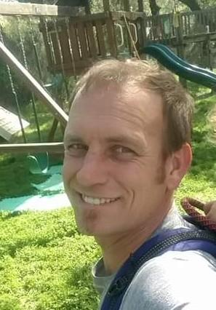
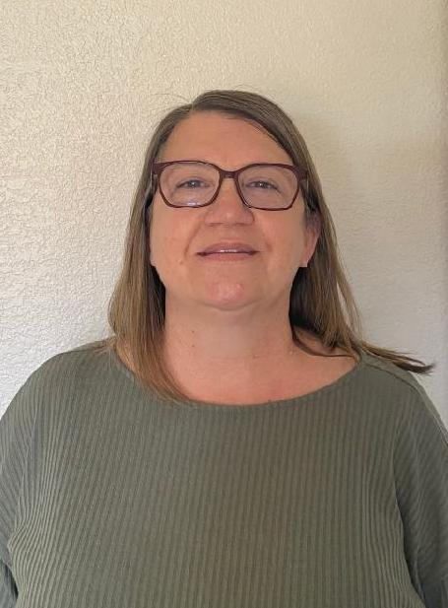
M&O Staff
District Office
Justin Carrion - Director of Facilities, Maintenance and Operations 1 year
Chantal Tadlock - Administrative Assistant 15 years

Slide 13
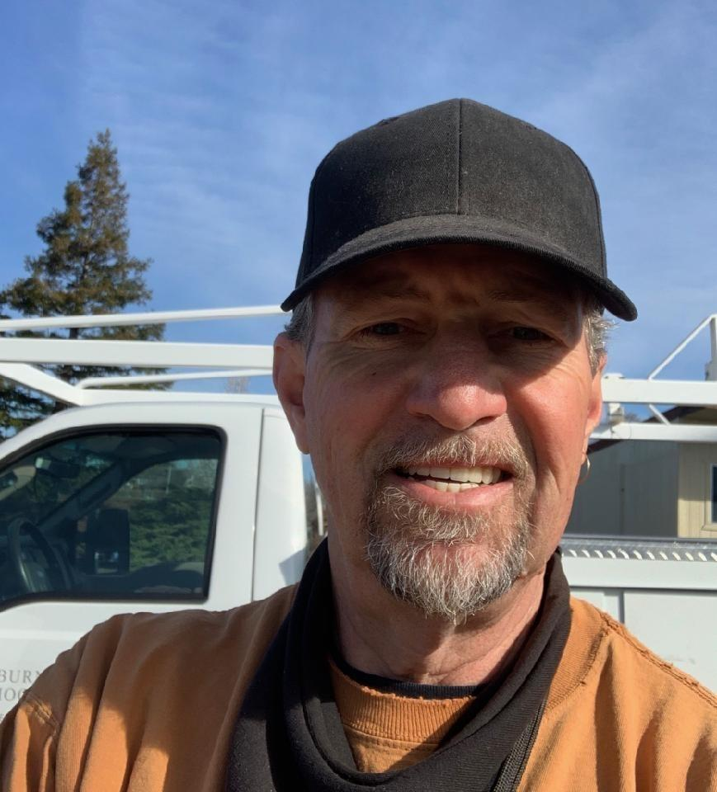
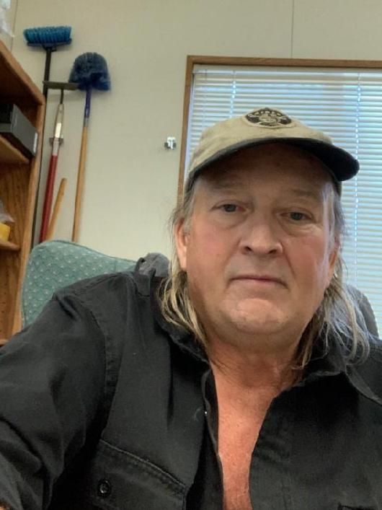

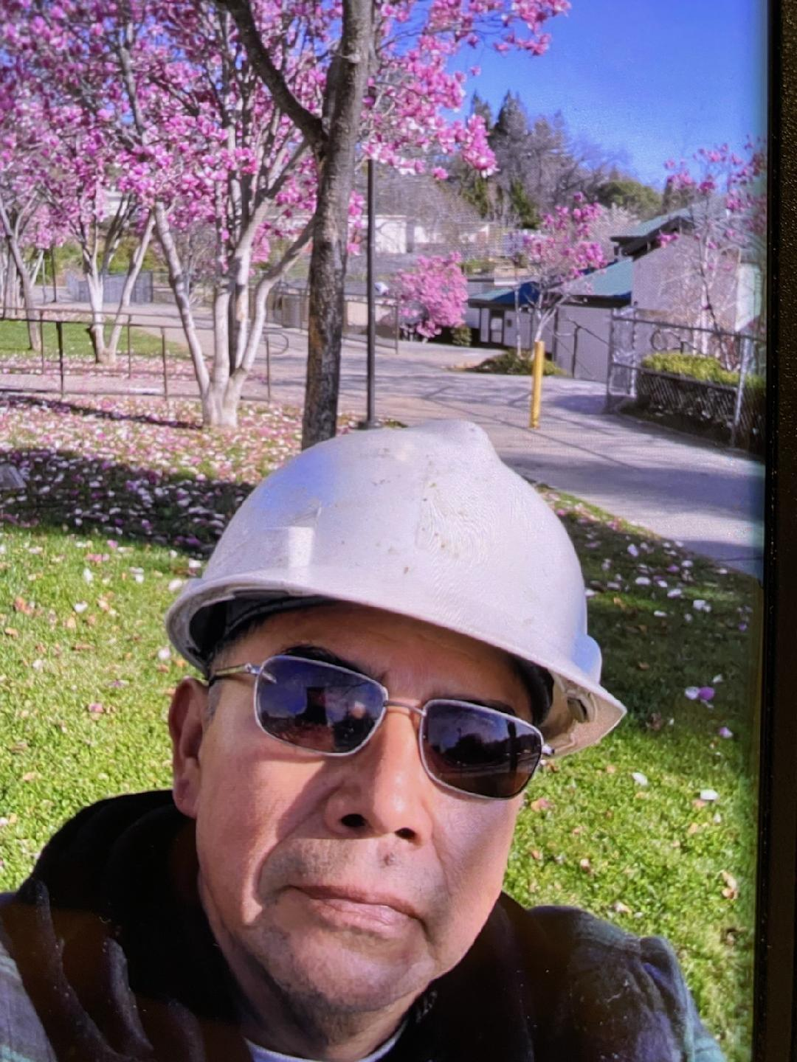
M&O Staff
Maintenance
Kevin Gove - Facilities Specialist, Rock Creek/Alta Vista 5 years
Victor Sassman - Facilities Specialist, Auburn Elementary/District Office 10 years
Facundo Marquez - Facilities Specialist, EV Cain 21 years*
Andrew Rocha - Facilities Specialist, Skyridge/Alta Vista 11 years
Notes:
Maintains 50.76 acres of school sites and 74.65 acres of undeveloped sites

Slide 14
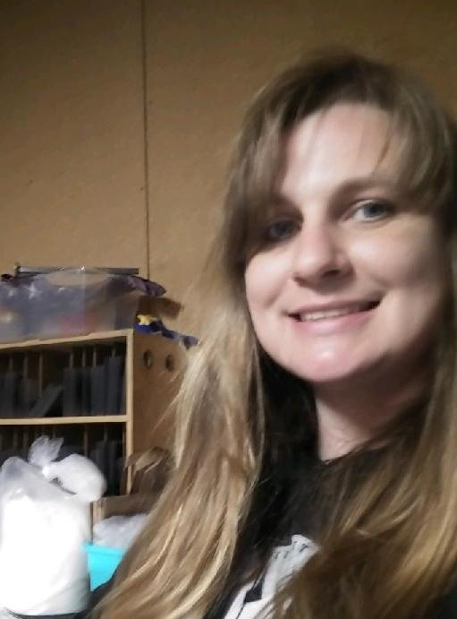

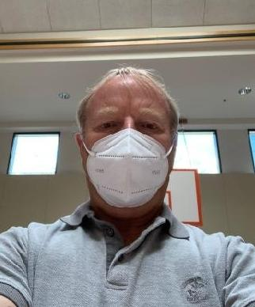



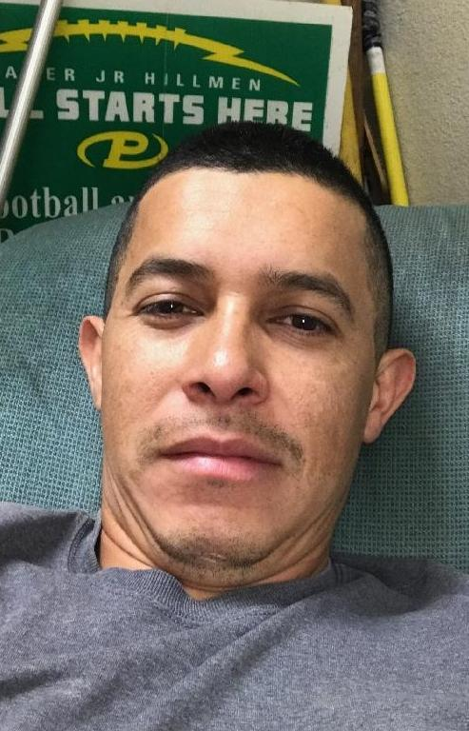
M&O Staff
Operations
Jessica McGuire - Day Maintenance/Custodian, Rock Creek 20 years*
Maria Salazar - Night Custodian, Rock Creek 2 years
Rick Morford - Day Maintenance/Custodian, Auburn Elementary 31 years*
Dakota Heckler - Night Custodian, Auburn Elementary 5 years
Pedro Orellana - Day Maintenance/Custodian, EV Cain 16 years
Henock Ramirez - Night Custodian, EV Cain 7 years
Kayden Barrios - Night Custodian, EV Cain 1 year

Slide 15
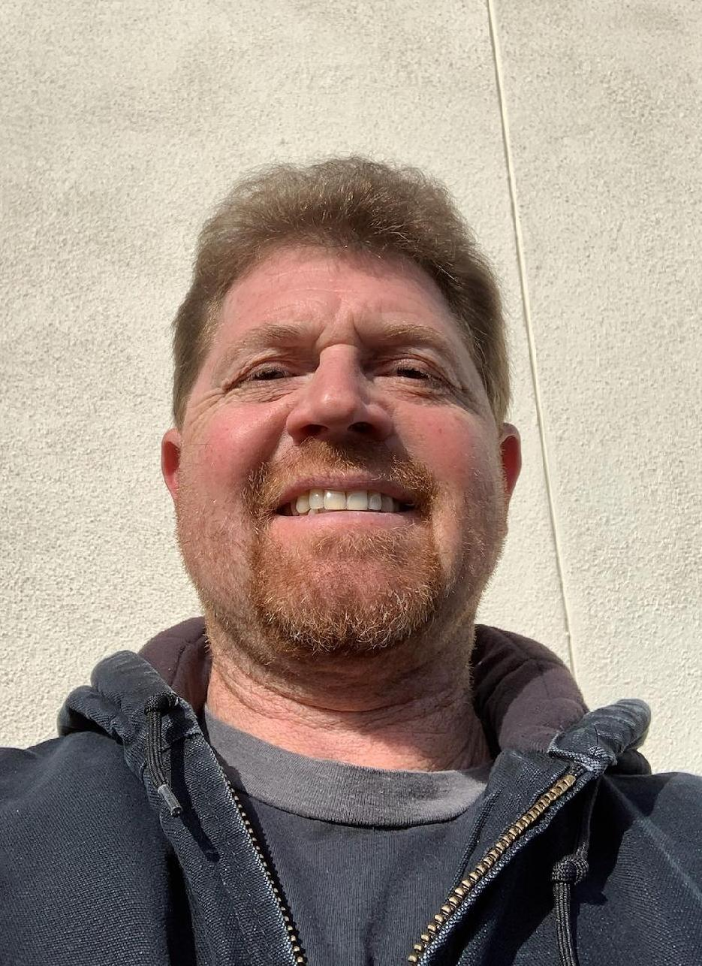

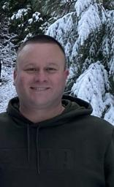
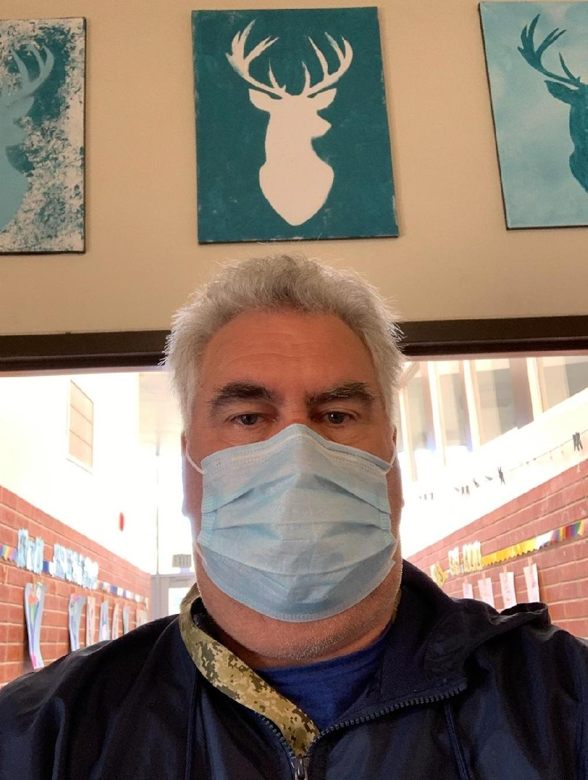
M&O Staff
Operations
Will Kesler - Day Maintenance/Custodian, Skyridge 1 year
Arnold Johnson - Night Custodian, Skyridge 2 years
Michael (Scott) Daly - Day Maintenance/Custodian, Alta Vista 2 years
Aaron Bosch - Night Custodian, Alta Vista/District Office 4 years

Slide 16
What do we do?
Plumbing
.
Tree
Pruning
Smiles
Painting
Custodial
Minor Electrical
HVAC
Filters
Grounds
Construction

Slide 17
What do we source out?
Major Electrical
HVAC
Repairs
HVAC
Repairs
Pest Control
Asphalt
Repairs/striping
Tree
Falling

Slide 18
217 Work Orders
Complete or in progress this last year
21.6 %
18.9 %
13.4 %
Alta Vista
Auburn Elementary
EV Cain
27.2 %
14.3 %
4.6 %
Rock Creek
Skyridge
District Office
Notes:
While 217 may seem like a lot of work, this does not capture the work performed by our dedicated staff. We try to balance work loads to accommodate the daily requests made directly to the M&O staff. I am working with each site to add these request to the work order system so we can capture the data and balance workload. Please note the majority of work goes into the oldest schools.

Slide 19
Step 4
Staff member works on issue and changes status to complete in Public Works
Step 1
Staff reports issues to Principal or Administrative Assistant.
Work Order
Flow
Step 3
Director of M&O reviews the work order and assigns to the appropriate staff member.
Step 2
School Principal or Assistant uses the work order function in Public Works.

Slide 20
District Compliance Reports
Site Inspections:
  Fire safety Inspections- annual - Spring
  Facility Inspections (FIT/Williams) - annual - due by October
  Playground Equipment Inspection - annual (continual) - Due in July
  Elevator Chair-Lift Inspection - annual - due July
  Emergency Shut Off - School Sites - annual - due August
Pesticide Use:
  Integrated Pest Management Plan to website - annual - August
  Notice to Staff & Parents - annual - August
  Pesticide Use Report - annual - January

Slide 21
District Compliance Reports
Asbestos:
  6 month surveillance & plan update - December & July
  3 year reinspection and plan update - Scheduled for 7/21
  Notice to parents & building occupants - July
Facilities/Custodial Supplies/Safety:
  Bloodborne Pathogens clean up and disposal - August
  Supplies - Blood Borne Pathogens PPE Supplies - August
  First Aid Kit Supplies - August
  Forklift laboratory label and Operating rules posted - August
  Hazardous Chemical Labeling - annual - August

Slide 22
District Compliance Reports
Facilities/Custodial Supplies/Safety (continued):
  Machine Guards - annual - August
  Portable Ladder Inspection - annual - July
  SDS Posters & Stickers - annual - July

Slide 23
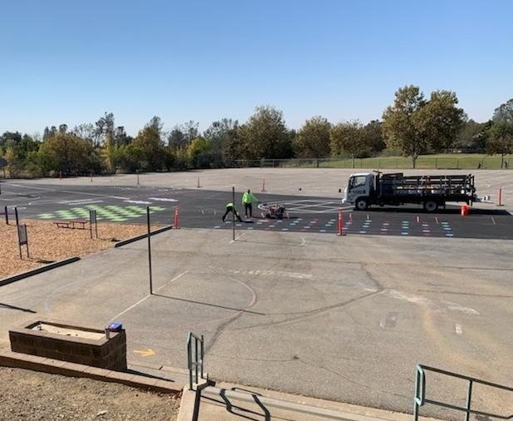

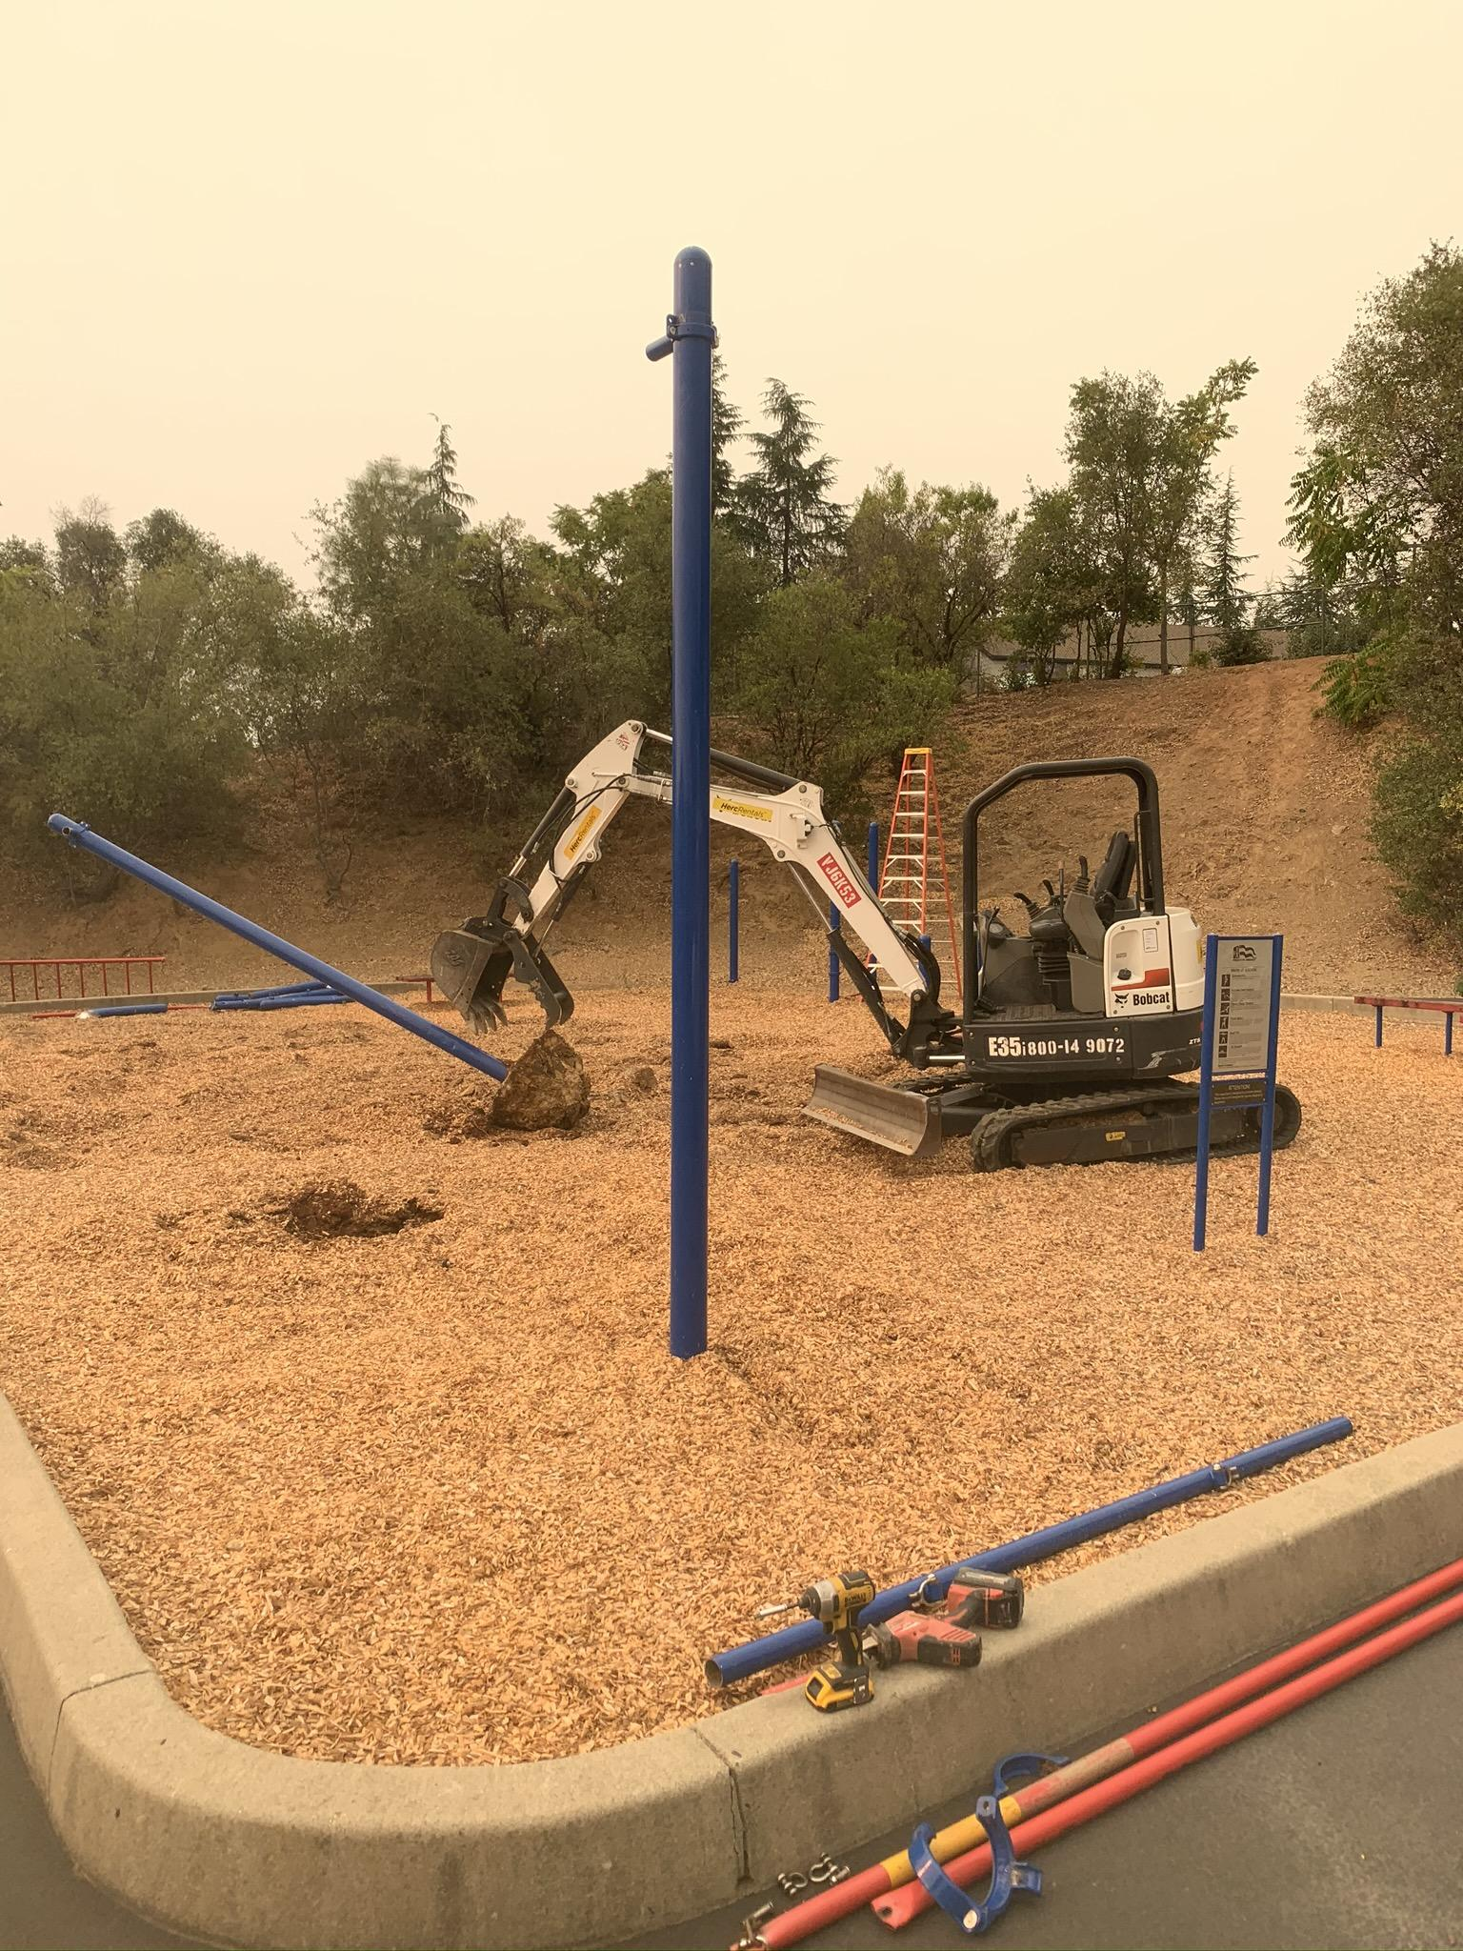
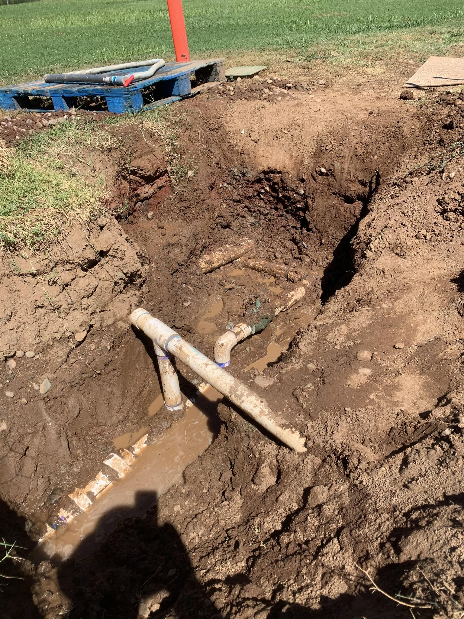
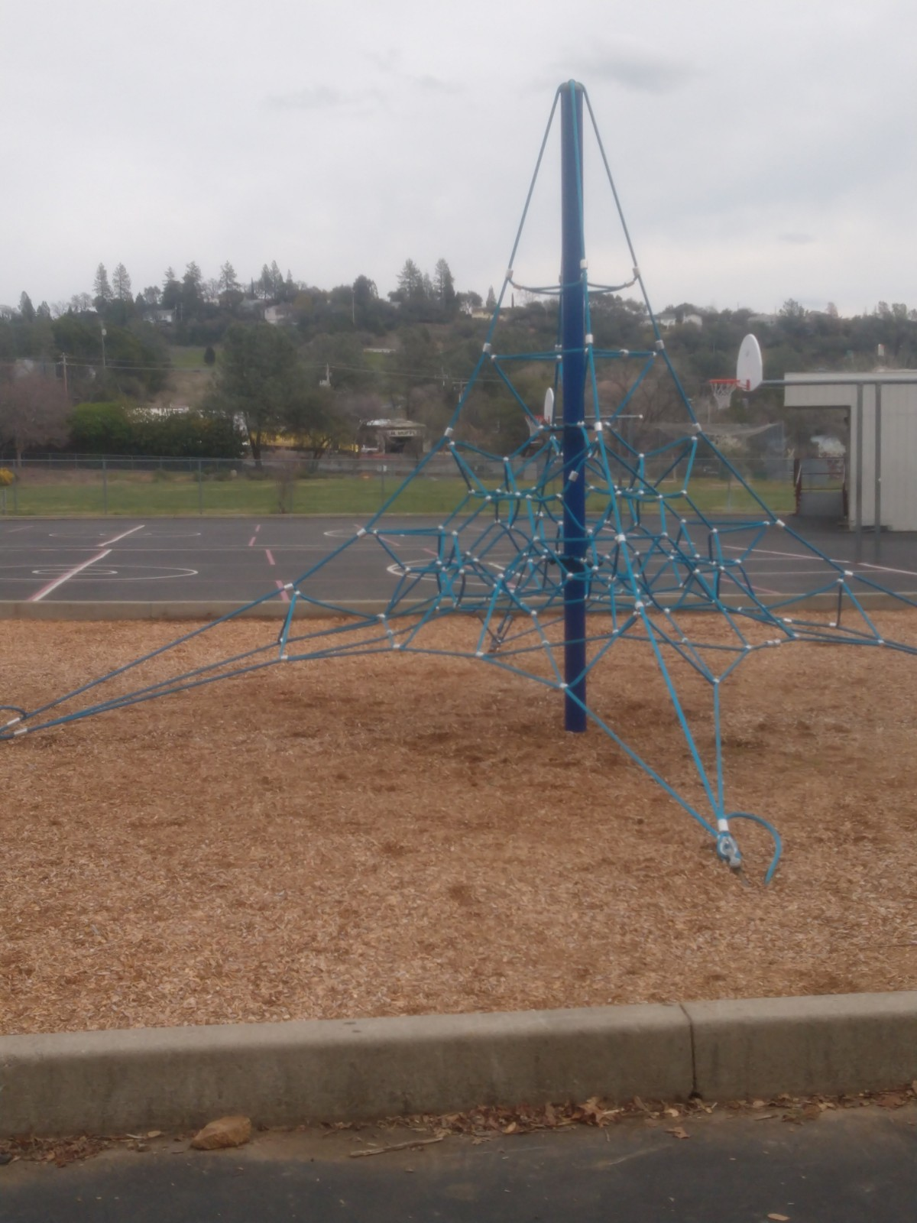
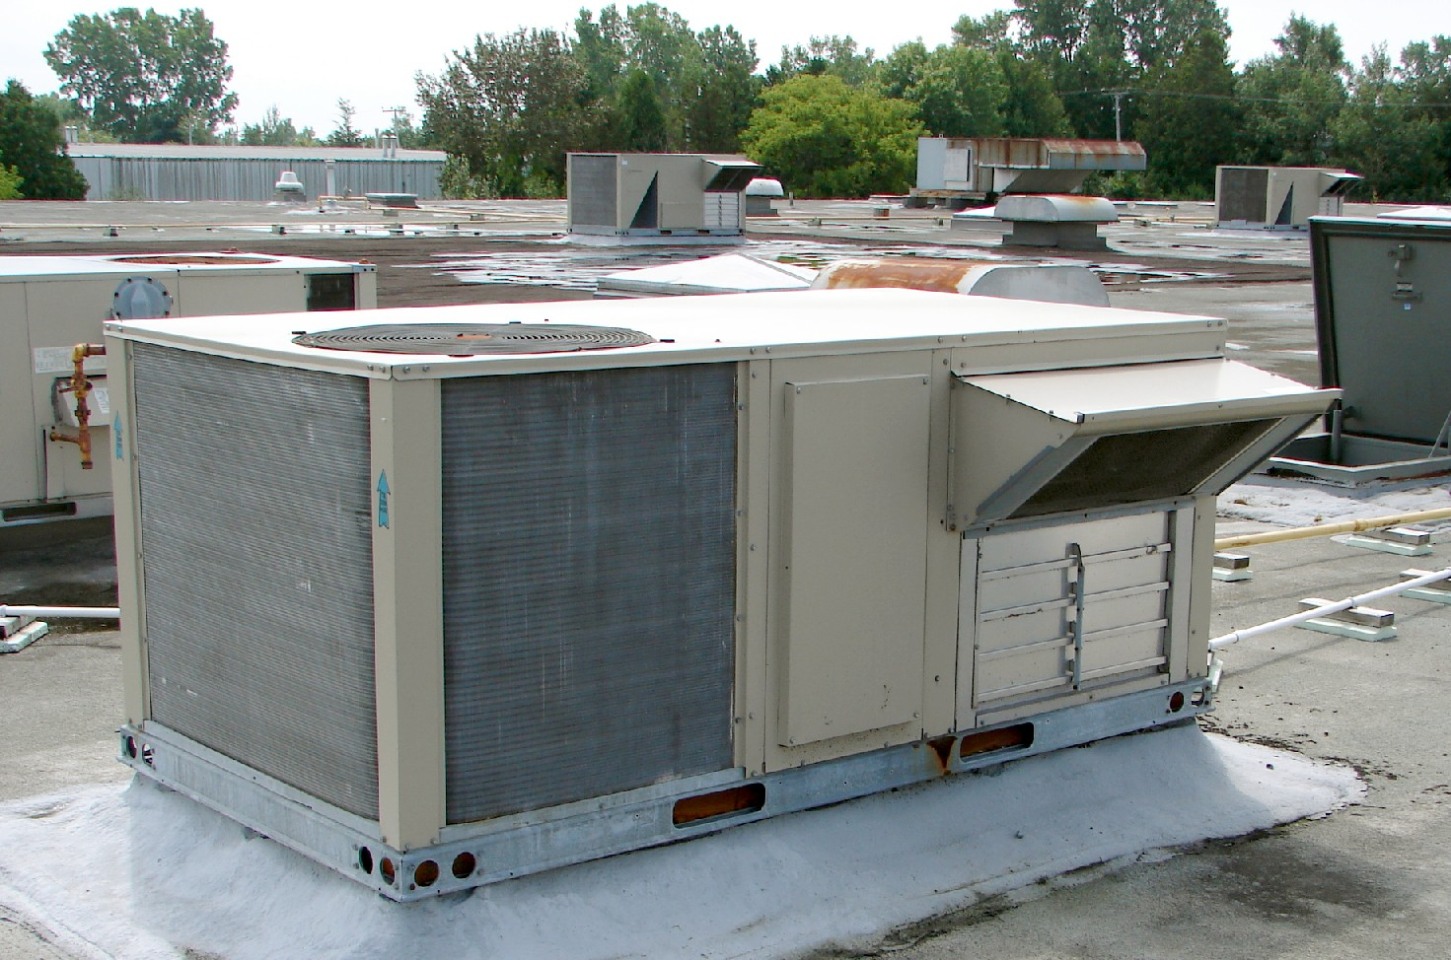
20/21 Projects Completed
HVAC upgrades
Lighting retrofit
Sports field irrigation
Blacktop improvements
Playground structures
Hazardous tree mitigation

Slide 24
Summer / Spring break projects
Soil, seed and fertilize sports fields
Reside damaged siding at EV Cain and Auburn Elementary
Painting
Seal and stripe blacktops and parking lots as funds allow
Tree and brush removal
Continue lighting retrofit
Gutter Repairs

Slide 25
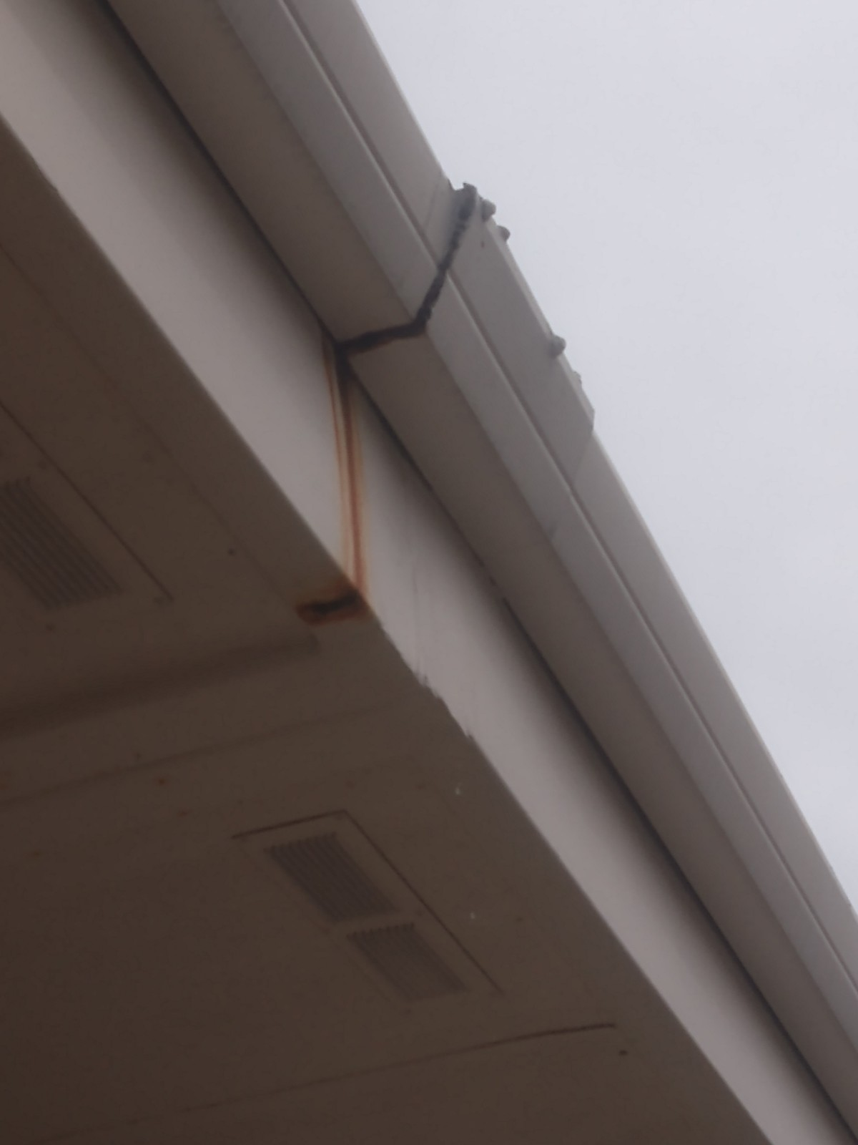
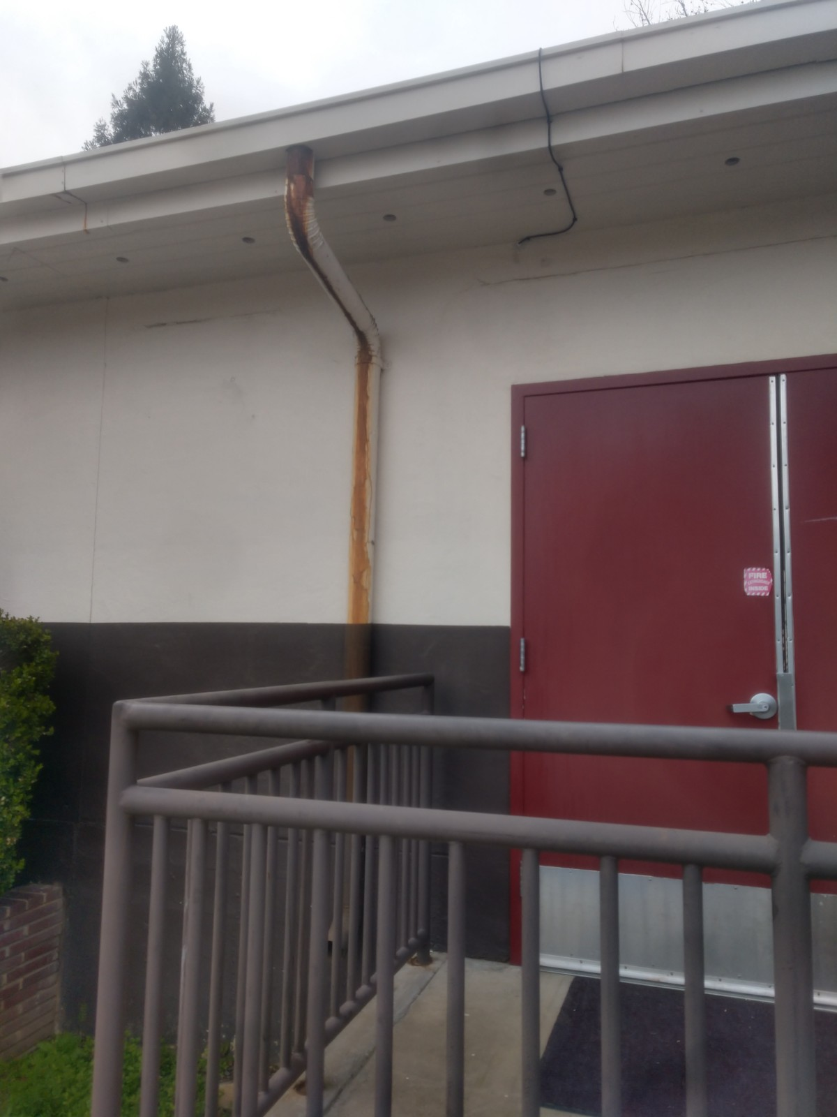
Future Projects
Roofing/gutter repairs
Notes:
AV ,RC, EV

Slide 26
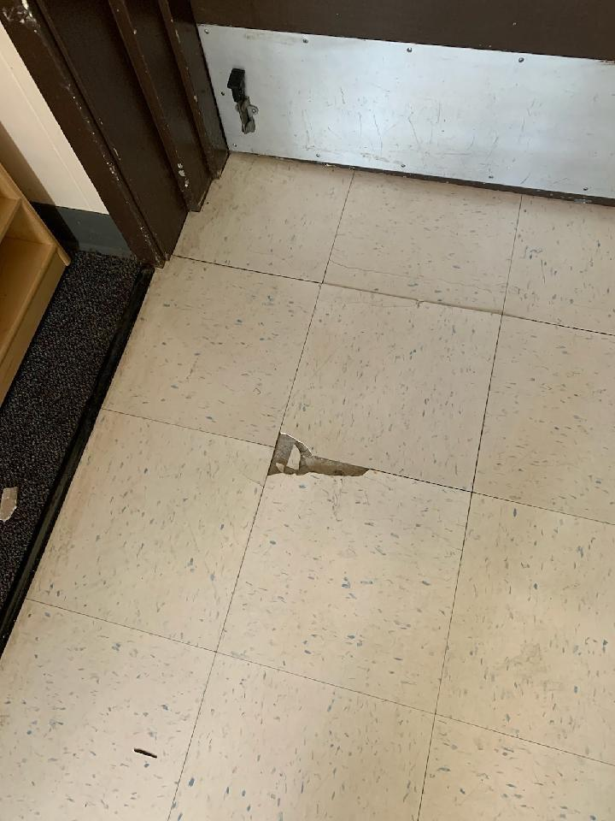
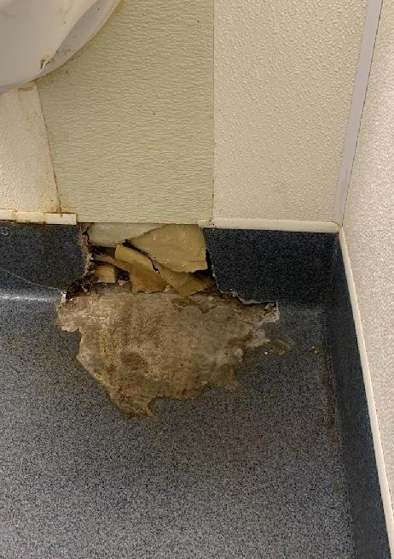
Future Projects
Flooring repairs
Notes:
All schools

Slide 27
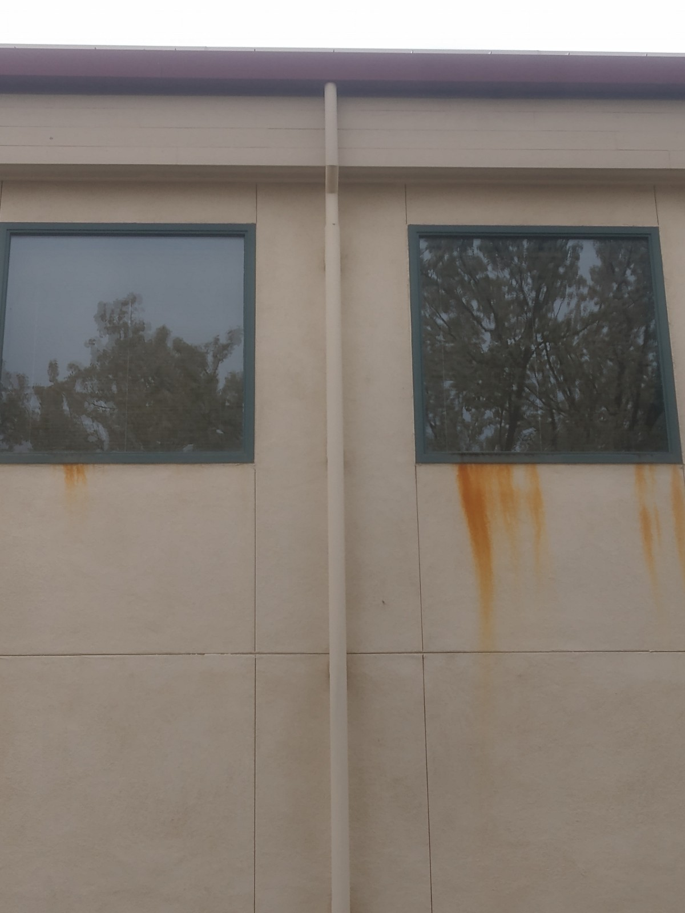
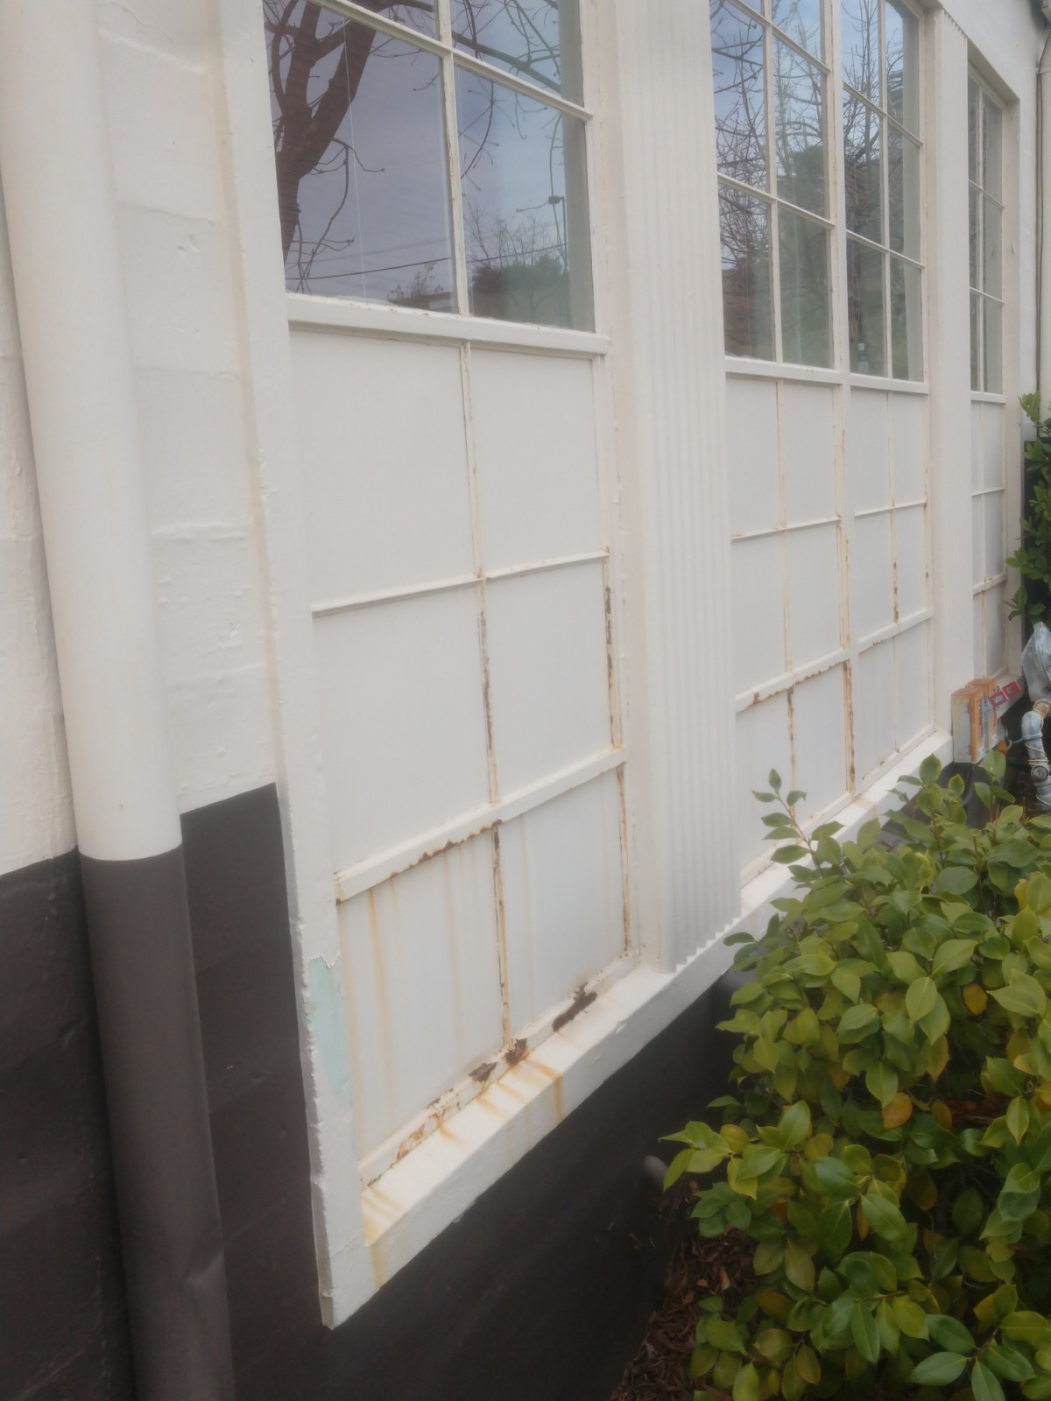
Future Projects
Exterior painting
Notes:
All schools

Slide 28


Future Projects
Portable classroom siding replacement
Notes:
AE, EV, SR, RC

Slide 29


Future Projects
Erosion control
Notes:
Issues at AV, SR, EV, AE
Donation made by Earth Saver

Slide 30


Future Projects
Sports field renovation
Notes:
EV, SR, AE
Common problem with water efficient sprinkler retrofits

Slide 31


Future Projects
Parking lot repair, seal and stripe

Slide 32

Future Projects
Finish blacktop playground seal and striping

Slide 33



Future Projects
Increased use of battery operated equipment
=
reduce air and noise pollution
Notes:
Lighter equipment
Often more powerful

Slide 34


Future Projects
New data management and work order system
Notes:
Digital blueprints
Asset inventory : HVAC, electrical. Plumbing, fire safety
Work orders

Slide 35



Covid related changes in operations
1:1 Student barriers
Electrostatic Sprayers
Carpet extractors/sanitizer
Daily cleaning
Provisioning and distribution of PPE
Daily playground sanitizing
Directional markings
Notes:
Sprayers = static charge to bond solution to surface, nozzles to adjust particle size

Slide 36
“If you can't explain it simply, you don't understand it well enough.”
- Albert Einstein

Slide 37
We provide the foundation for student success.

Slide 38


Thank you!
Justin Carrion
jcarrion@auburn.k12.ca.us
530-745-8806

Slide 39
Facilities Master Plan & Facilities Funding
Cathy Dominico from Capitol Public Finance Group will present at the April board meeting to review the debt payoff plan
Review Facilities Master Plan with board (created in 2018) - update cost projections
Sell surplus property to fund deferred maintenance
Review options for modernizing our facilities

